Slide 1





Green Mindset Mastery
Reducing the environmental footprint of Female Entrepreneurship
WomEn Going Greener

Slide 2

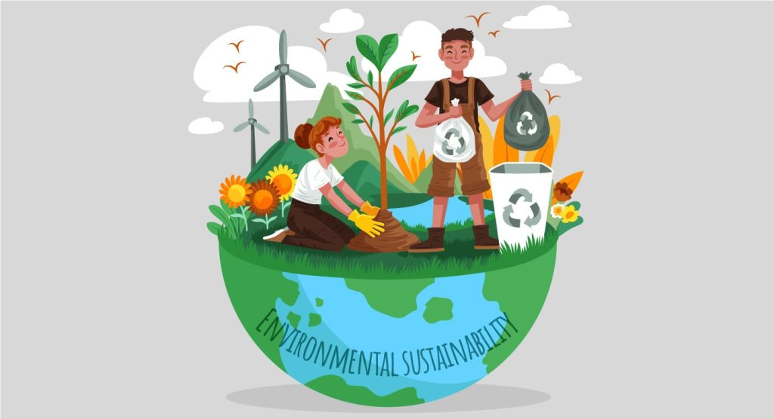
CULTIVATE A SUSTAINABLE MINDSET
  In today’s rapidly changing world the need for sustainable practices has become more urgent than ever.
  Entrepreneurs play a crucial role in shaping the future as we grapple with environmental challenges such as climate change, resource depletion, and pollution.
  Green entrepreneurship, specifically, focuses on creating businesses that prioritize environmental sustainability, social responsibility and economic viability.
  The Earth must be protected and to save it “green” behaviour must be implemented, but not everyone is equally committed: it is mostly women who live ethically and sustainably.

Slide 3
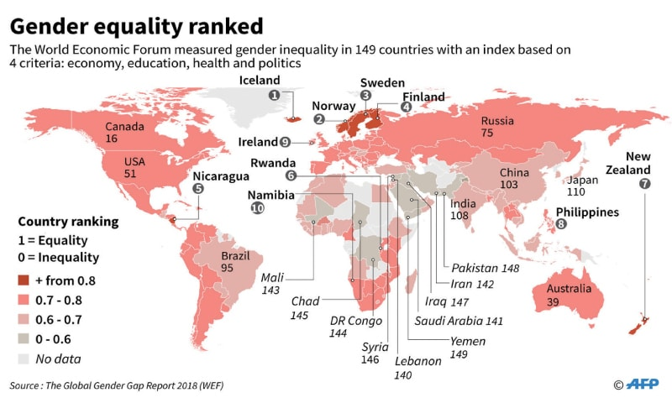
WHAT IS THE ORIGIN OF THE GAP BETWEEN MEN AND WOMEN?
According to Ducket, it could have the same roots as the differentiation of roles within today society:
Women still tend to take charge of the household while men believe that taking care of the environment somehow undermines their masculinity.
Ogilvy Earth reports how being an environmentalist has generated an all-female stereotype
Men avoid eco-friendly behaviour because of the fear that others might question their sexual orientation.
Encoureages good finance management and best results
Operational framework to maintain connections

Slide 4
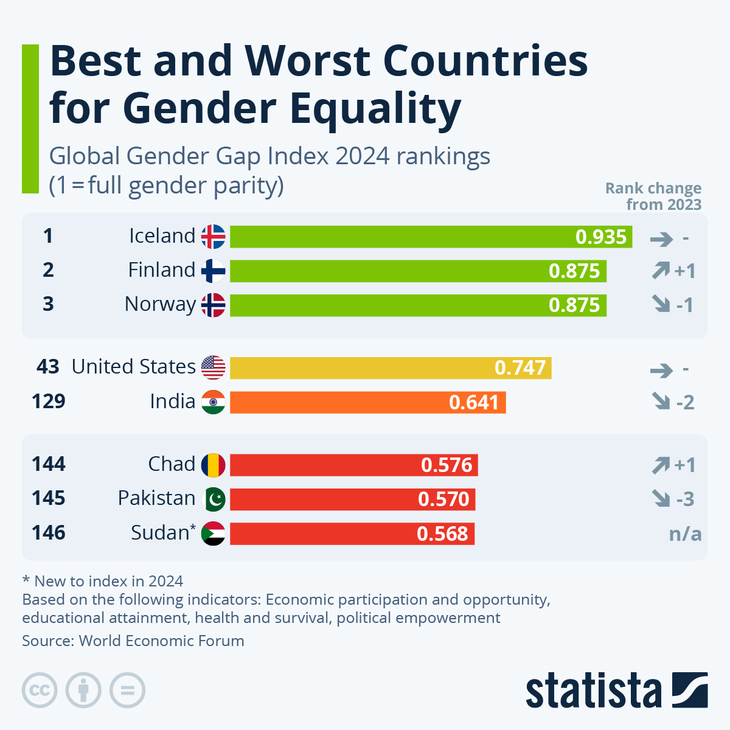
WOMAN IN THE GLOBALISED ECONOMY
The woman plays a significant role in the economic development of any country.​
​
Women contribute and support the economy extensively in different ways by being employed in many different sectors.​
​
Women entrepreneurs in both developed and developing countries are socially powerful in terms of education and making a positive impact on the society.
In 2024, no country has achieved gender equality. One in three countries have made no progress since 2015, and the situation of women has even deteriorated in 18 countries, such as Venezuela, Afghanistan and South Africa. At the current rate of progress, it will take another 131 years to achieve gender equality worldwide.

Slide 5
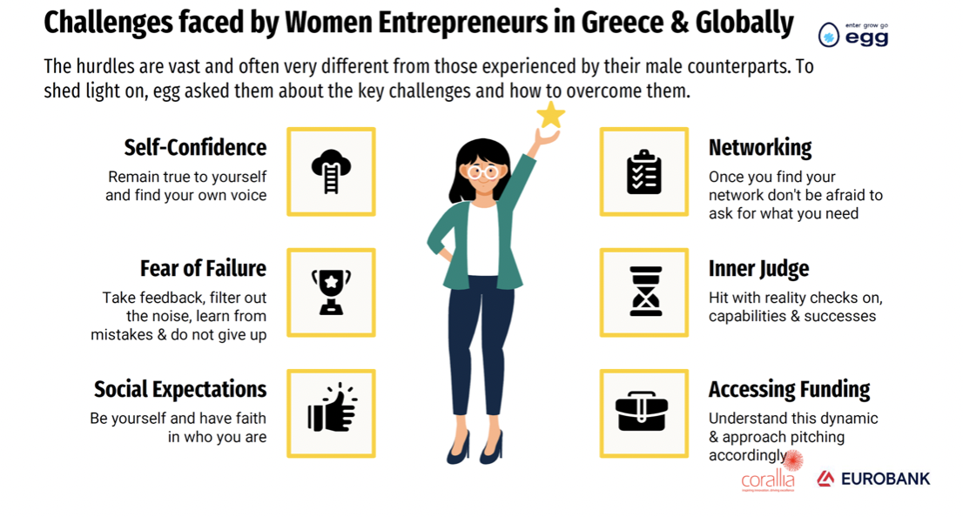
OVERCOMING BARRIERS TO CHANGE
An increasing number of women across the world have established startups in different niches, despite the barriers that exist.
Despite more women taking the entrepreneurial plunge, they still face many challenges that make it difficult.
Some of the barrier’s women entrepreneurs face and some ways to continue moving forward are:
LIMITED FUNDING
GENDER BIASES
WORK-LIFE BALANCE
LACK OF SUPPORT
COVID-19 PANDEMIC

Slide 6
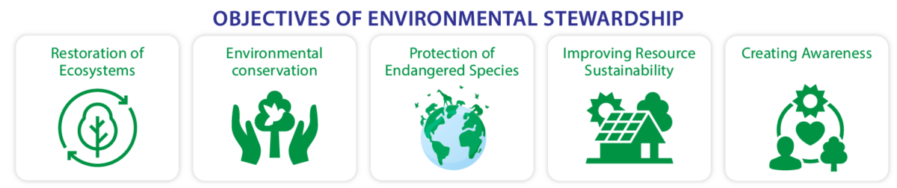
ENVIRONMENTAL STEWARDSHIP
We define environmental stewardship as the responsibility for environmental quality shared by all those whose actions affect the environment. This sense of responsibility is a value that can be reflected through the choices of individuals, companies, communities, and government organizations, and shaped by unique environmental, social, and economic interests.
Stewardship calls for a range of behaviors. These behaviors often include sacrifice on the part of individuals to benefit ecosystems that communities depend on, as well as influencing the behaviors of others within the community.

Slide 7
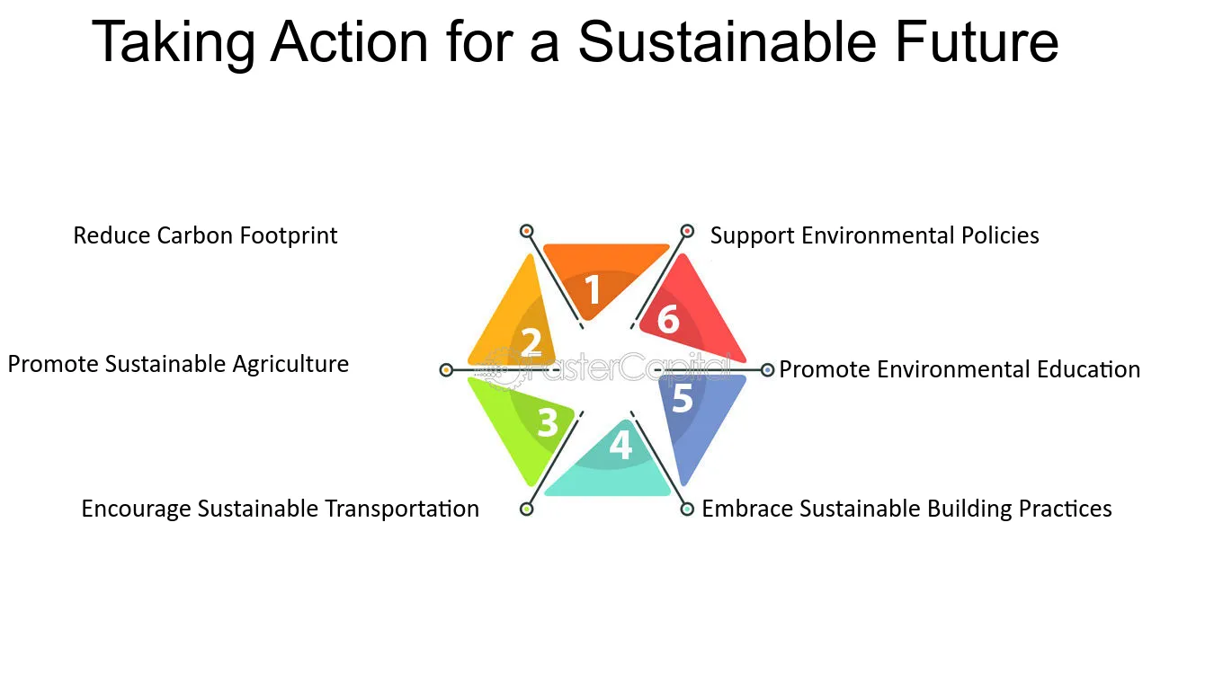
HOW CAN WE BECOME ENVIRONMENTAL STEWARDS?

Slide 8

There are also several reasons why supporting women in green and climate-related enterprises could lead to additional business gains and drive more sustainable impact:
Women tend to be more impacted by climate change and related challenges;
Women outperform on environmental, social, and governance metrics when compared to men, including in the realm of entrepreneurship;
Women perform better in leadership, problem-solving, and innovation, which can contribute to advancing green technologies and climate solutions.

Slide 9
Thank you very much!
2023-1-EL01-KA210-ADU-000164781
The European Commission suport for the production of this publication does not constitute an endorsement of the contents which reflects the views only of the authors, and the Commission can not be held responsible for any use which may be made of the information contained therein

