Slide 1





Eco-Enthusiasm Uleashed
Reducing the environmental footprint of Female Entrepreneurship
WomEn Going Greener

Slide 2

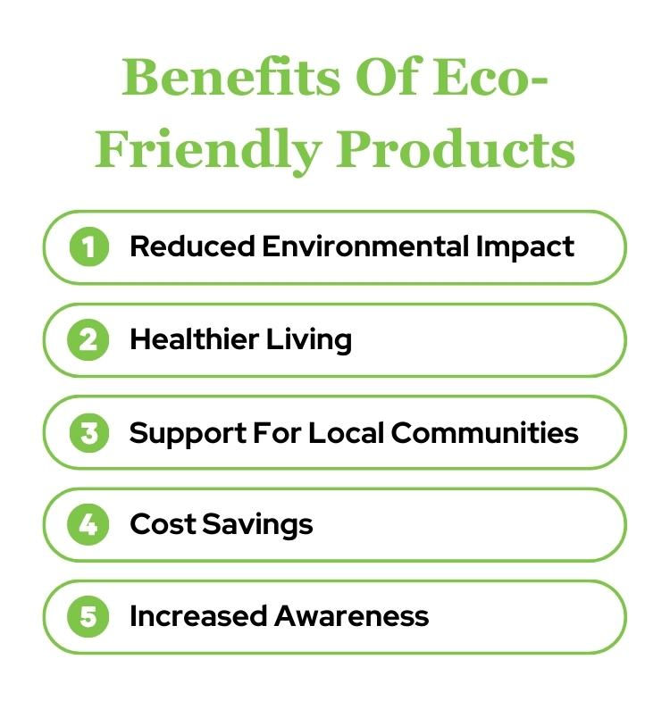
SOME OF THE BENEFITS OF BEING ECO-FRIENDLY
The most important benefits of sustainable living include:
Improved health;
Lower energy bills;
Reduced carbon footprint;
Reduced energy consumption;
Greater biodiversity.

Slide 3
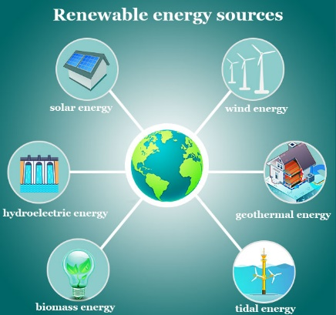
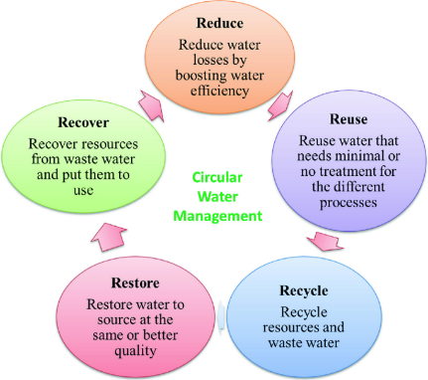
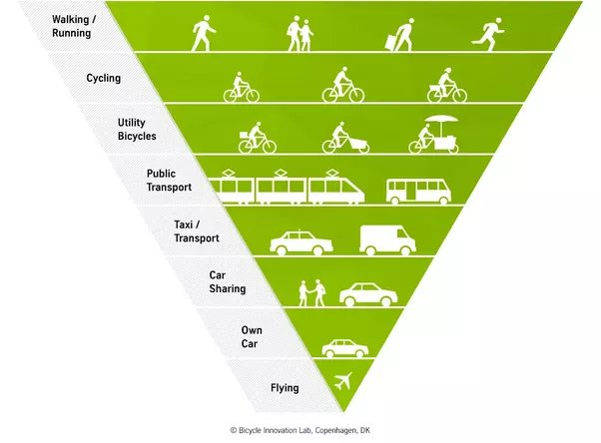
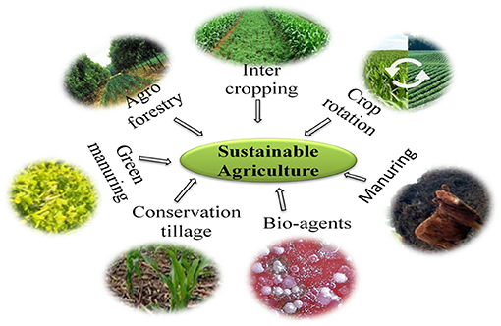
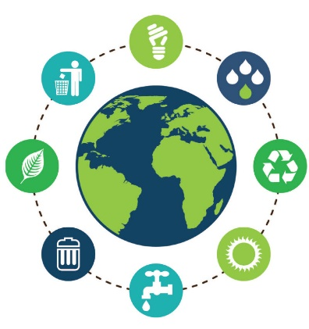
What are sustainable practices?
When we speak of sustainable practices, we refer to actions and behaviors that aim to meet present needs without compromising the ability of future generations to meet their own needs. These practices prioritize long-term environmental, social, and economic well-being.
Some examples are:
Renewable Energy Sources
Sustainable Water Management
Sustainable Transportation
Sustainable Agriculture
Efficient Resource Use
Encoureagod finance management and best results

Slide 4
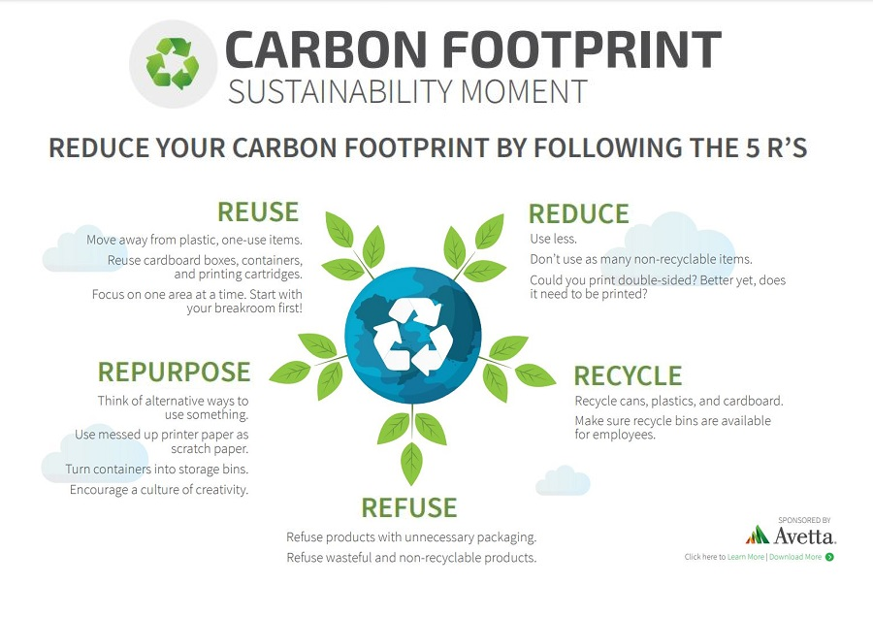
Sustainable practices are vital for preserving our ecosystems, protecting biodiversity, and combating climate change. By reducing emissions, conserving natural resources, and minimizing pollution, we can help ensure a healthier planet for future generations. They also have social benefits; they can lead to cleaner air and water, healthier communities, and improved quality of life.

Slide 5
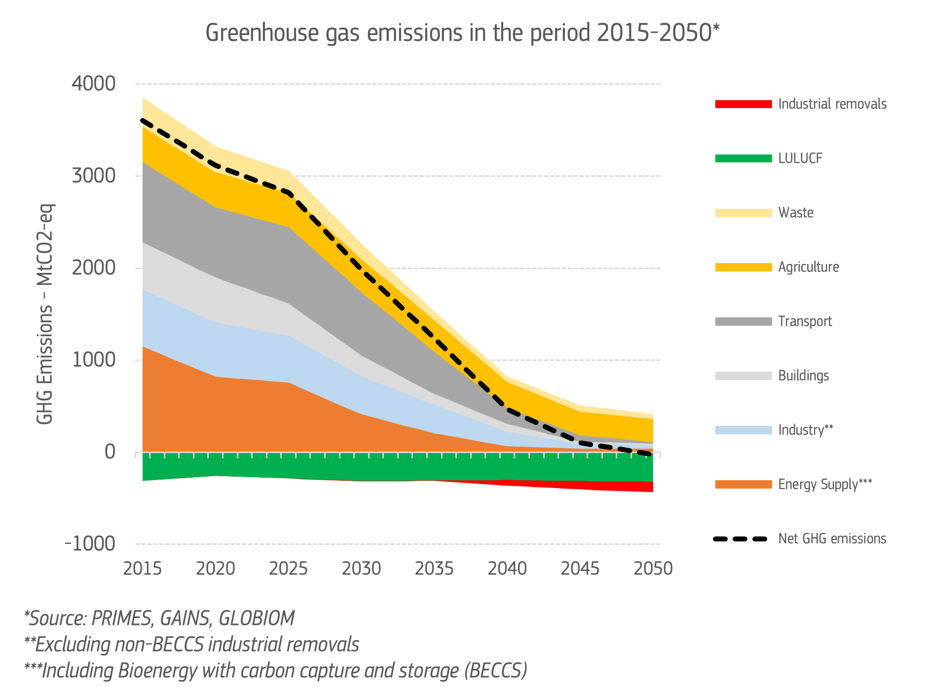
A GREENER FUTURE CAN ONLY BE ACHIEVED IF IT IS ALSO A MORE EQUAL ONE
Women are key economic actors. As business leaders, investors, employees and customers, they play a vital role in shaping the way that markets and societies behave.
Increasing women’s participation in the work force and closing the pay gap between women and men will have a positive impact on economic growth in the EU. Despite recent improvements, there are still persistent gender gaps in labour market activity and pay

Slide 6
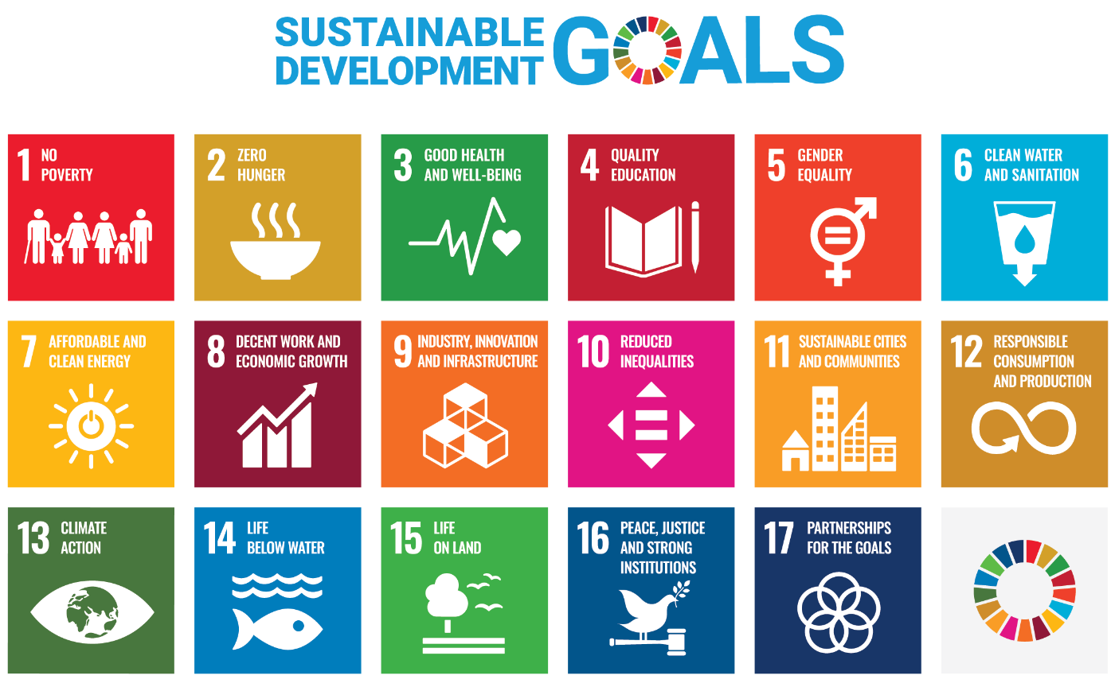
WHY WOMEN SHOULD PREFER PRODUCTS THAT FOLLOW SUSTAINABLE PRACTICES?
Women play a crucial role in ensuring the effectiveness and efficiency of sustainable development efforts. Their full and equal participation in decision-making and policy development is essential to create and maintain this pathway. Mainstreaming women’s greater participation in these roles is also crucial in ensuring the achievement of the UN Sustainable Development Goals (SDGs).
The Sustainable Development Goals Progress Chart 2023 presents a comprehensive overview of global progress with respect to the targets outlined in the 17 Goals of the 2030 Agenda for Sustainable Development. Among the 169 targets, 138 can be assessed based on both available global data and analysis conducted by custodian agencies, while 31 targets lack su cient data or additional analysis for the trend assessment.

Slide 7
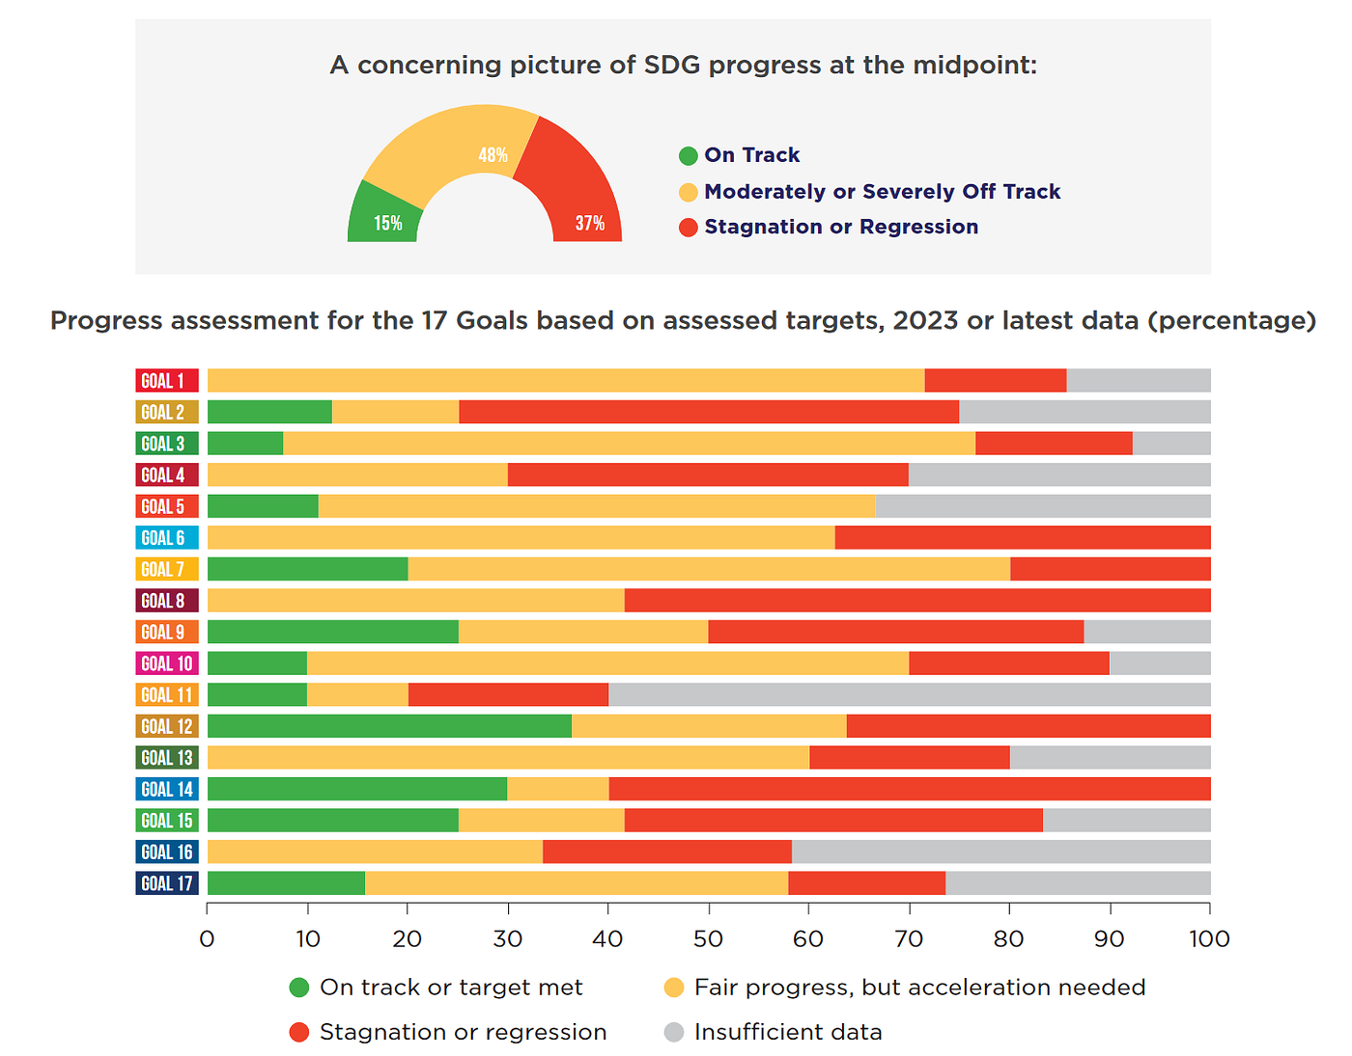
Among the assessable targets, a mere 15 per cent are on track to be achieved by 2030. Nearly half—48 per cent—of the targets that can be assessed show moderate or severe deviations from the desired trajectory. Furthermore, over one-third—37 per cent—of these targets have experienced no progress or, even worse, have regressed below the 2015 baseline. This comprehensive assessment underscores the urgent need for intensified e orts to ensure the Sustainable Development Goals stay on course.

Slide 8
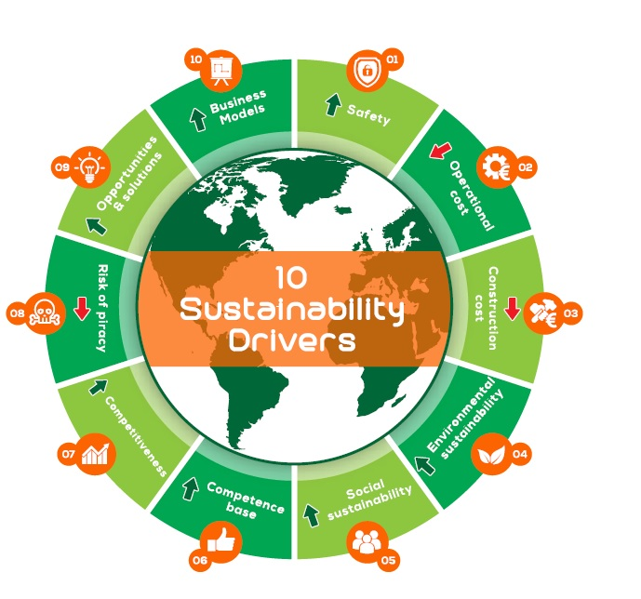
SOCIAL DRIVERS OF SUSTAINABLE DEVELOPMENT
A central aspect of the social dimensions of sustainable development relates to social conditions and factors that shape processes of change. These “social drivers” relate to social structures and institutions that shape people’s preferences, behaviour and possibilities, and to agency, that is, the capacity of individuals and groups to influence change.

Slide 9
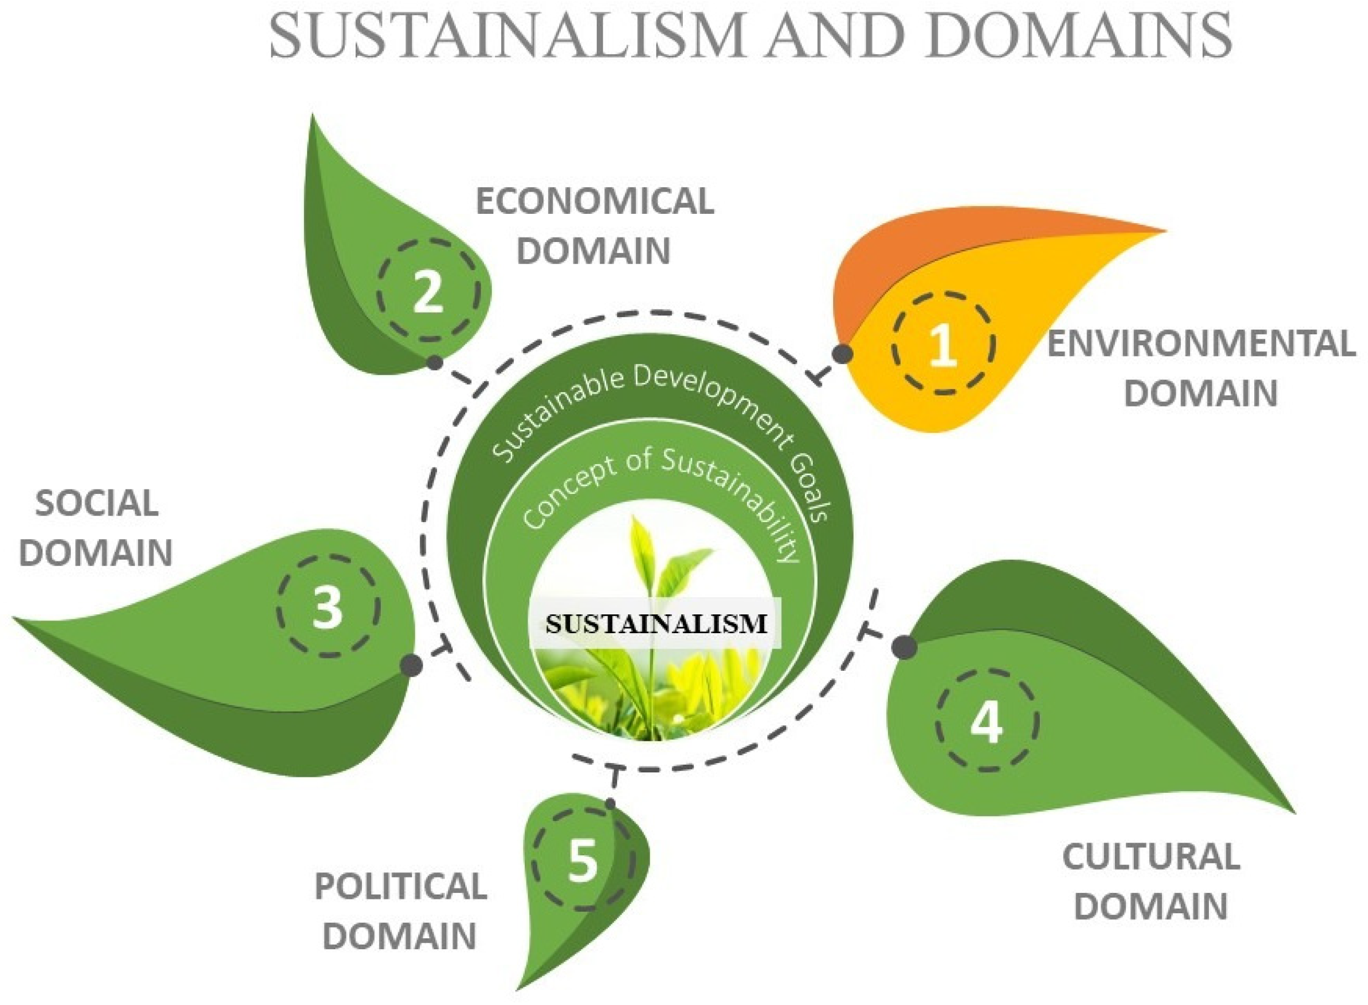
SOCIAL POLICIES CAN INFLUENCE PROFUND TRANSFORMATIONS ACROSS THE SOCIAL, ECONOMIC AND ENVIRONMENTAL DOMAINS
Social policies are interventions by governments that affect the welfare of individuals and communities.
Beyond this protective function, social policies can influence profound transformations across the economic, environmental and social domains—supporting economic productivity, raising human capital, reducing inequalities and sharing the burden of social reproduction—driving development outcomes in a more sustainable direction.
Social policies thus play an essential role not only in reducing poverty but also in fostering economic development and in creating socially inclusive societies.

Slide 10
Italian, Greek and Serbian social policies
To improve its policy coherence, Italy set out a National Action Plan for Policy Coherence for Sustainable Development (NAP PCSD) in 2022. It aims to strengthen governance tools and mechanisms; improve the dialogue between central and local administrations, civil society and other stakeholders; ensure co-ordinated action for sustainable development; and promote systematic analysis and monitoring of policy impact and synergies across all relevant sectors and stakeholders.
Greece presented its Voluntary National Reviews in 2018 and 2022. The first VNR of Greece reflects on the institutional mechanism operating in the country, ensuring both high-level political commitment and the conduct of social dialogue, government policies developed within the framework of the 8 national priorities for the SDGs and their interconnection with specific SDGs, as well as the new National Development Strategy. The second VNR in 2022 highlights the challenges and strategies related to three successive crises: the aftermath of the decade-long national recession, with the persistent economic and social issues it caused, the subsequent COVID-19 pandemic, which exerted significant pressure on the National Health System and the economy, and the consequences of the recent geopolitical turmoil in the European continent (Ukraine).

Slide 11
Serbia will contribute to the achievement of the SDGs of the 2030 Agenda through a series of measures and activities, thereby reaffirming its sustained commitment to improving the living conditions of all its citizens in all three dimensions of sustainable development: economic growth, environmental protection and social inclusion. This political determination of Serbia is based on analyzes of the planning framework related to the achievement of 17 SDGs and relevant data, and was also confirmed at the UN Summit on Sustainable Development Goals held in September last year in New York, where transformative and accelerated actions to meet the goals set until 2030 were presented.

Slide 12
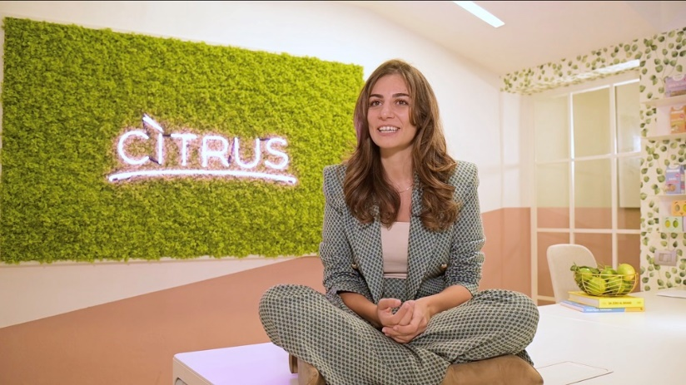

INSPIRATIONAL SUCCESS STORIES FROM ENTREPRENEURS
In the late 19th and early 20th century, women with an entrepreneurial flair began to see the possibility of realising their business ideas. The time was ripe enough for a sector that had always been the preserve of men alone to start opening up to them. Not without difficulty, because as we know, the road to a complete normalisation of the role of women in the world of work cannot be said to be finished.
Among the various women who have been successful in the business sphere are:
Marianna Palella, with her mother Paola Pappalardo, founded Citrus l'Orto Italiano in 2015, a fruit and vegetable company that enhances Made in Italy excellence and brings a wide variety of fresh fruit and vegetables to Italian homes, including even products, such as bergamot, that would normally only be destined for the beauty sector.
There are more than 15 thousand points of sale in Italy and abroad where it is possible to taste the delicacies of the Mulan Group, the company founded in 2002 and now led by 27-year-old Giada Zhang. Mulan, today, combines traditional Chinese recipes with the quality of Italian ingredients with the ambition of bringing together the Italian and Chinese culinary worlds.

Slide 13
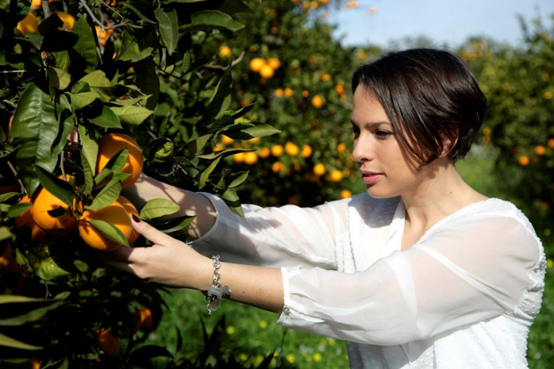

Orange Fiber is the name of the company led by Enrica Arena that transforms orange peel waste from the fruit juice industry into fabrics. The Sicilian citrus fruit par excellence thus becomes the protagonist of a circular economy project that links the food and fashion sectors, finding innovative solutions under the banner of zero waste. Since its foundation in 2014, the company has achieved numerous milestones. In 2017, the first fashion show with the Florentine Maison Ferragamo, and in 2019 first the selection for H&M's Conscious Exclusive Collection and then the capsule collection with the historic tie brand Marinella.
Growing cedars in the shade of photovoltaics is the bet won by Mariangela Lancellotta of LeGreenhouse, the first consortium of Italian farms to combine electrical and agricultural production. Around fifty people work in Calabria, Sardinia and Umbria, whose crops now include lemons, limes, oranges, clementines, Sardinian pompia and various vegetables.

Slide 14
Thank you very much!
2023-1-EL01-KA210-ADU-000164781
The European Commission suport for the production of this publication does not constitute an endorsement of the contents which reflects the views only of the authors, and the Commission can not be held responsible for any use which may be made of the information contained therein

