Slide 1





Footprint Minimization Magic
Reducing the environmental footprint of Female Entrepreneurship
WomEn Going Greener

Slide 2

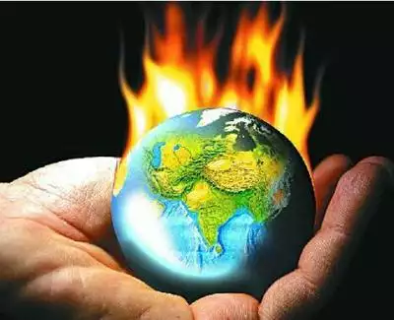

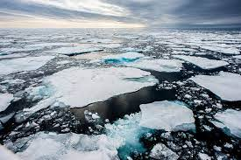

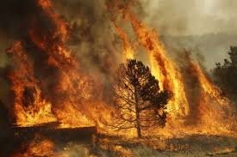
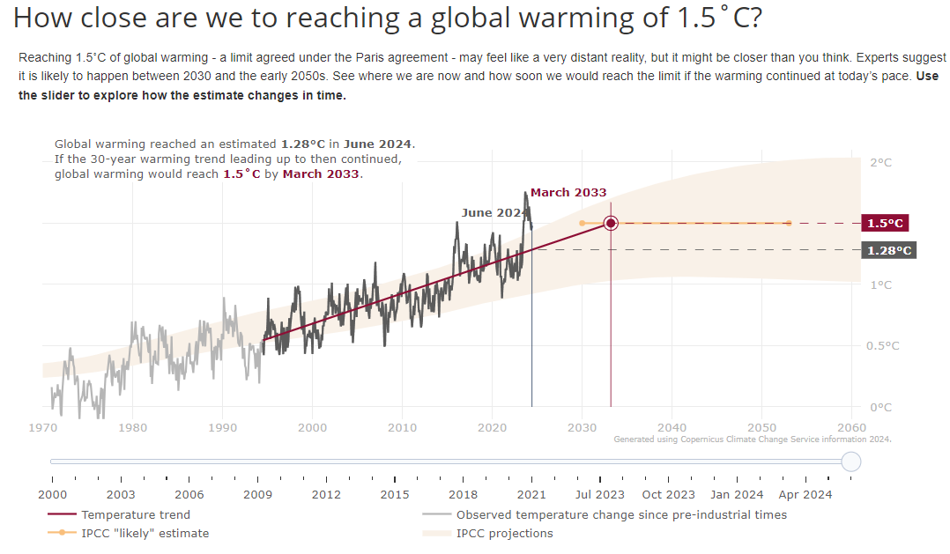

Introduction
Climate change:
  rise in average global temperature,
  change in rainfall patterns (catastrophic storms, flooding,
  melting of glaciers and snow,
  mean sea level rise,
  more frequent occurrence of droughts and fires, etc.
More and more people are talking about the climate crisis, not climate change!

Slide 3
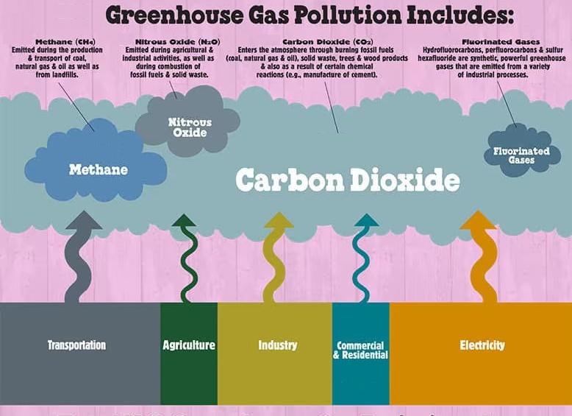
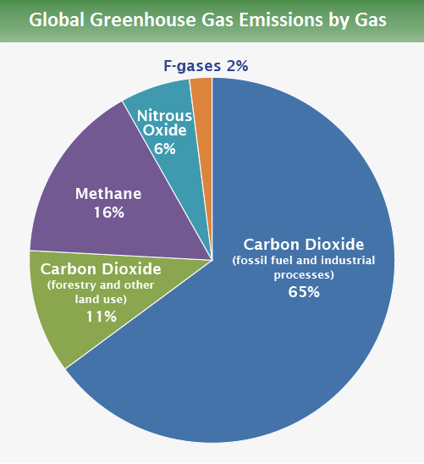
Greenhouse Gases
Climate change as a result of greenhouse gases (GHG) emitted by human activities:
  Carbon dioxide - CO₂
  Methane – CH₄
  Nitrous oxide - N₂O
  Fluorinated gasses (F – gasses: Sulphur hexafluoride - SF₆, Perfluorocarbons - PFCs, Hydrofluorocarbons - HFCs)
The concentration of these gases in the atmosphere is increasing due to human activity.

Slide 4
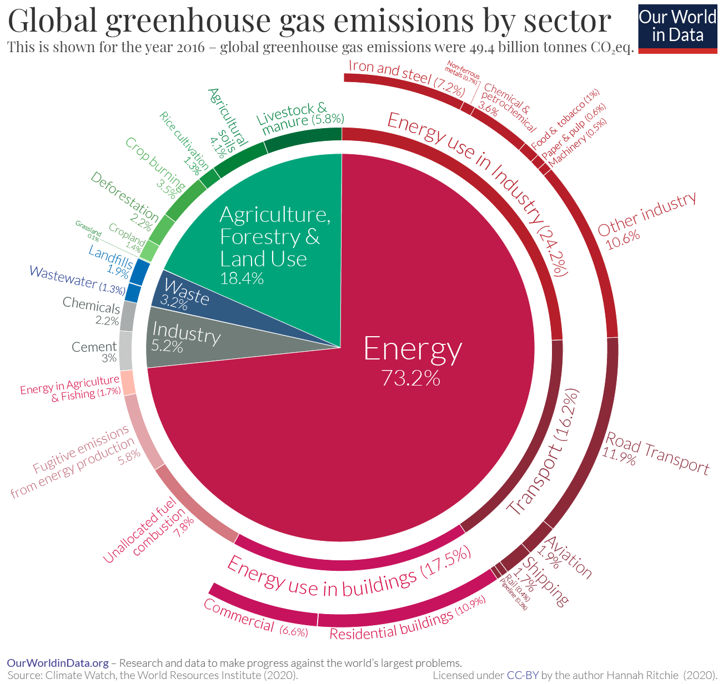

GHG Emissions in Industry
Global GHG emissions reached in 2022 the level of 53.8 Gt CO2eq
To curb global warming => GHG emission reduction
International agreement to limit the increase in the global average temperature to a maximum of 2°C, with a target of 1.5°C
About 30% of global emissions are caused by industry

Slide 5
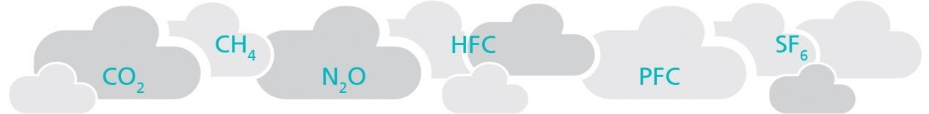




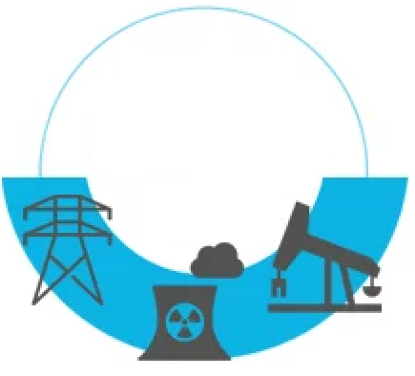

Industrial GHG emissions
Scope 1
Direct GHG emissions
Scope 2
Indirect GHG emissions
Scope 3
Indirect GHG emissions
GHG emission from energy consumed in the production process, production process and from vehicles owned by the company
GHG emission from the consumption of purchased electricity and/or thermal energy
GHG emissions from other activities not owned or controlled by the company
Advice on project monitoring methodologies
Usefull info to be referred at any time
Business trips
External activities
Waste disposal
Encoureages good finance management and best results
Operational framework to maintain connections
Transport
Employee travel
The GHG Protocol Corporate Accounting and Reporting Standard

Slide 6
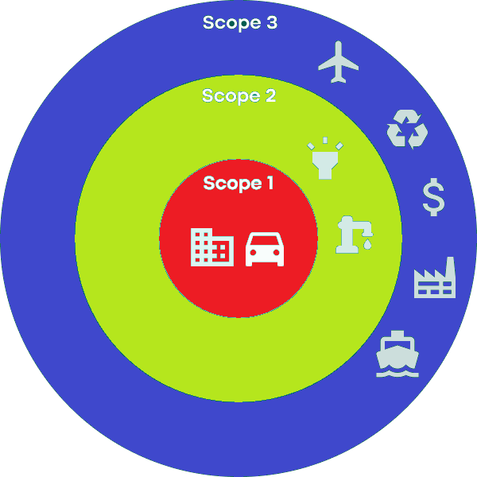
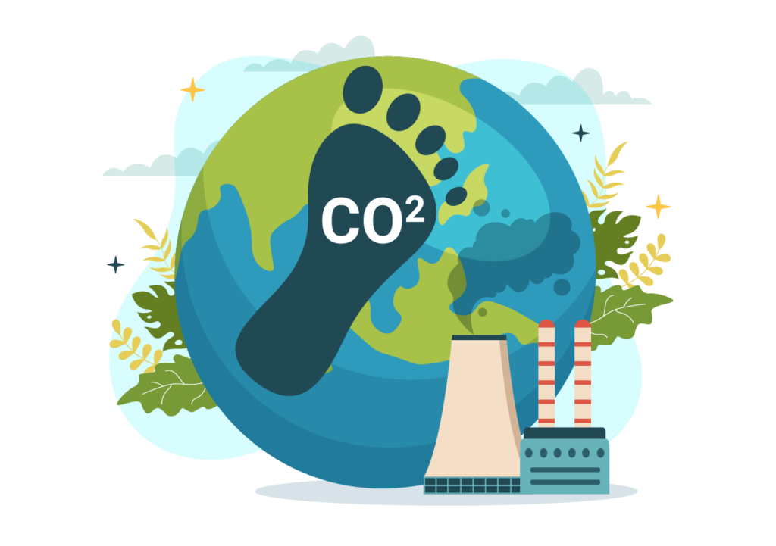

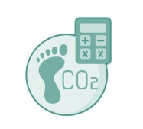
Carbon Footprint (GHG footprint)
Identify the Scope
Gather Data
Carbon Accounting

Slide 7
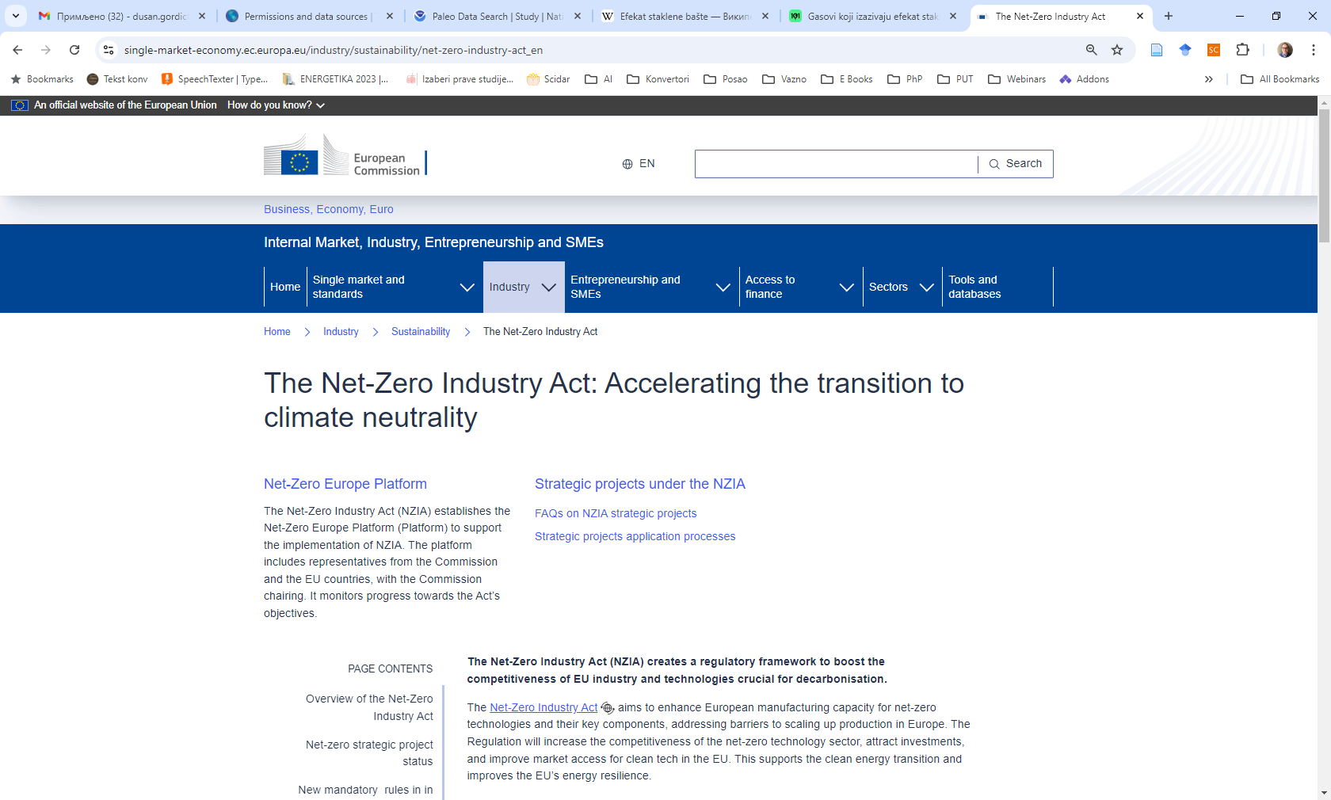
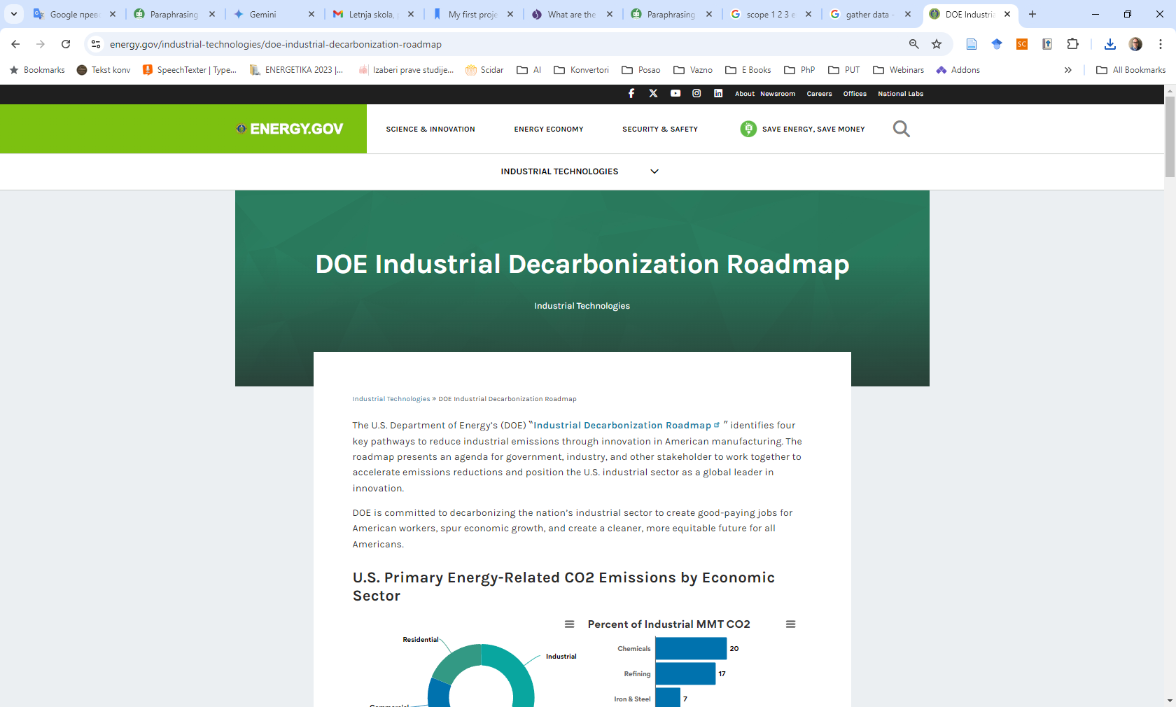
Industrial Decarbonisation

Slide 8


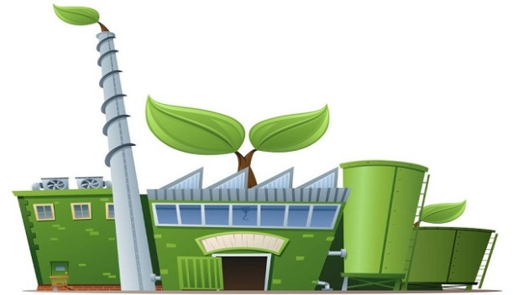


Technological Pathways for Decarbonising Industry
Energy efficiency
Electrification
Carbon Capture, Utilization, and Storage (CCUS)
Low‐carbon Fuels

Slide 9
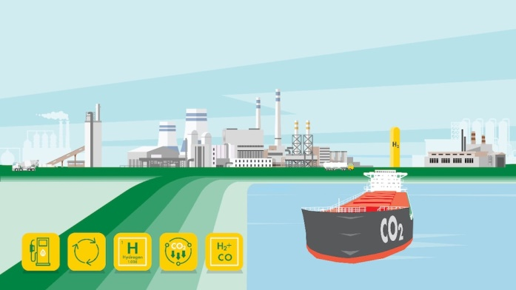

Solutions for Industrial Decarbonisation
86 commercially available, emerging, and experimental innovations for the iron and steel industry
78 commercially available, emerging, and experimental innovations for the food and beverage industry
32 emerging technologies for making ceramic manufacturing more sustainable
30 different innovations for making glass manufacturing more sustainable
40 decarbonisation interventions in oil refining plants
71 potentially transformative technologies for the decarbonisation of the chemical industry…
More than 250 different solution!
Energy efficiency
Electrification
References:
J. Kim, B. Sovacool, M. Bazilian, S. Griffiths, J. Lee, M. Yang. July 2022. Decarbonizing the iron and steel industry: A systematic review of sociotechnical systems, technological innovations, and policy options. Energy Research & Social Science 89 , 102565, pp. 1-32.
B. Sovacool, M. Bazilian, S. Griffiths, J. Kim, A. Foley, D. Rooney. June 2021. Decarbonising the food and beverages industry: A critical and systematic review of developments, sociotechnical systems and policy options. Renewable and Sustainable Energy Reviews.
D D. Furszyfer Del Rio, B. Sovacool, A. M. Foley, S. Griffiths, M. Bazilian, J. Kim, D. Rooney. April 2022. Decarbonizing the ceramics industry: A systematic and critical review of policy options, developments and sociotechnical systems. Renewable and Sustainable Energy Reviews 157. Elsevier.
D. D. Furszyfer Del Rio, B. Sovacool, A. M. Foley, S. Griffiths, M. Bazilian, J. Kim, D. Rooney. December 2021. Decarbonising the glass industry: A critical and systematic review of developments, sociotechnical systems and policy options. Renewable and Sustainable Energy Reviews. Elsevier.
S. Griffiths, B. Sovacool, J. Kim, M. Bazilian, J. Uratani . July 2022. Decarbonizing the oil refining industry: A systematic review of sociotechnical systems, technological innovations, and policy options. Energy Research & Social Science Reviews, Volume 89. Elsevier.
C. Chung, J.Kim, B. Sovacool, S. Griffiths, M. Bazilian , M. Yang. February 2023., Decarbonizing the chemical industry: A systematic review of sociotechnical systems, technological innovations, and policy options, Energy Research & Social Science 96, 102955, pp. 1-32.
Lo‐carbon Fuels

Slide 10
Energy Efficiency Solutions
Optimizing the production system for energy efficiency
  Installation of appropriate quality plants for energy generation/conversion (electricity, heating, cooling),
  Waste heat recovery,
  Switch to more efficient processes that achieve the same results,
Designing efficient energy distribution systems and their maintenance
  Reduction of losses in distribution systems by appropriate dimensioning, distance reduction, pipe insulation, avoiding 90° bends in pipes and ducts, etc.
  Management of leaks and uncontrolled use of steam, hot and cooling water and compressed air,
Proper selection of energy and process equipment
  Work around the optimal load,
Installing efficient equipment (pumps and fans that provide sufficient flow with minimal energy consumption, boilers with the best available technology, use of highly efficient controllable electric motors - such as variable speed drives),
System management for efficient operation
  Avoiding idling the equipment,
  Correcting/reducing variability in the process and production flow,
Introduction of the energy management system
Demand side interventions:
  Reduced use of materials: extended shelf life of products, greater intensity of product use and greater efficiency of materials,
  Additive manufacturing (3D printing),
  Substitution of low-carbon materials with high-carbon materials in products (construction materials industry),
  Circular economy.
Energy efficiency
Electrification
Lo‐carbon Fuels

Slide 11
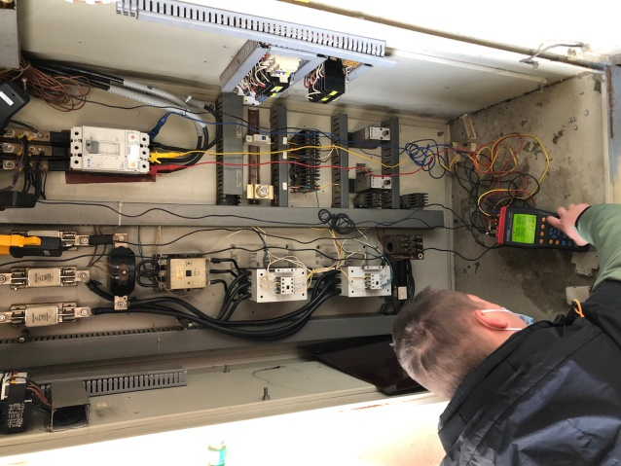
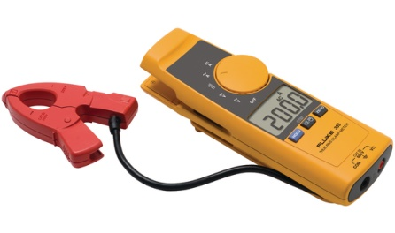



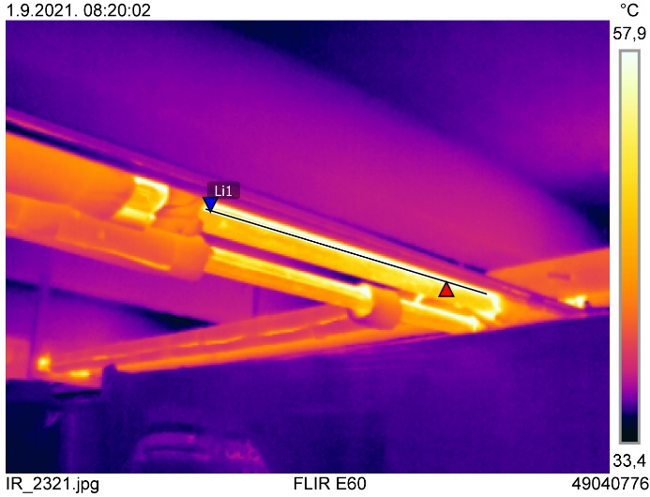
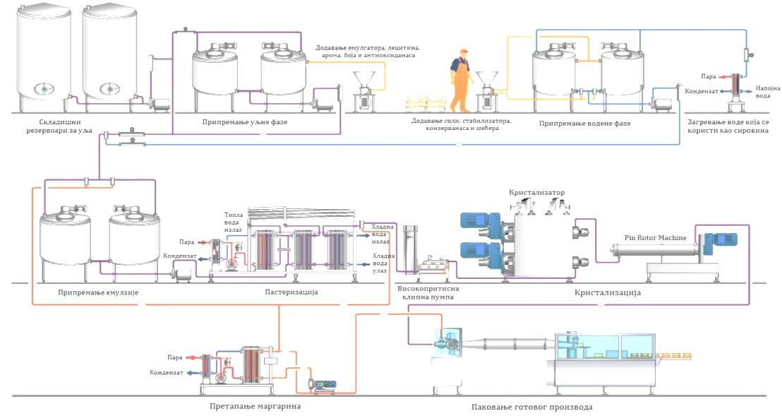

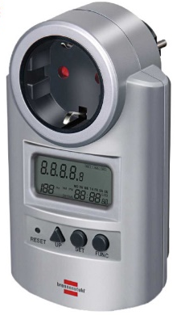
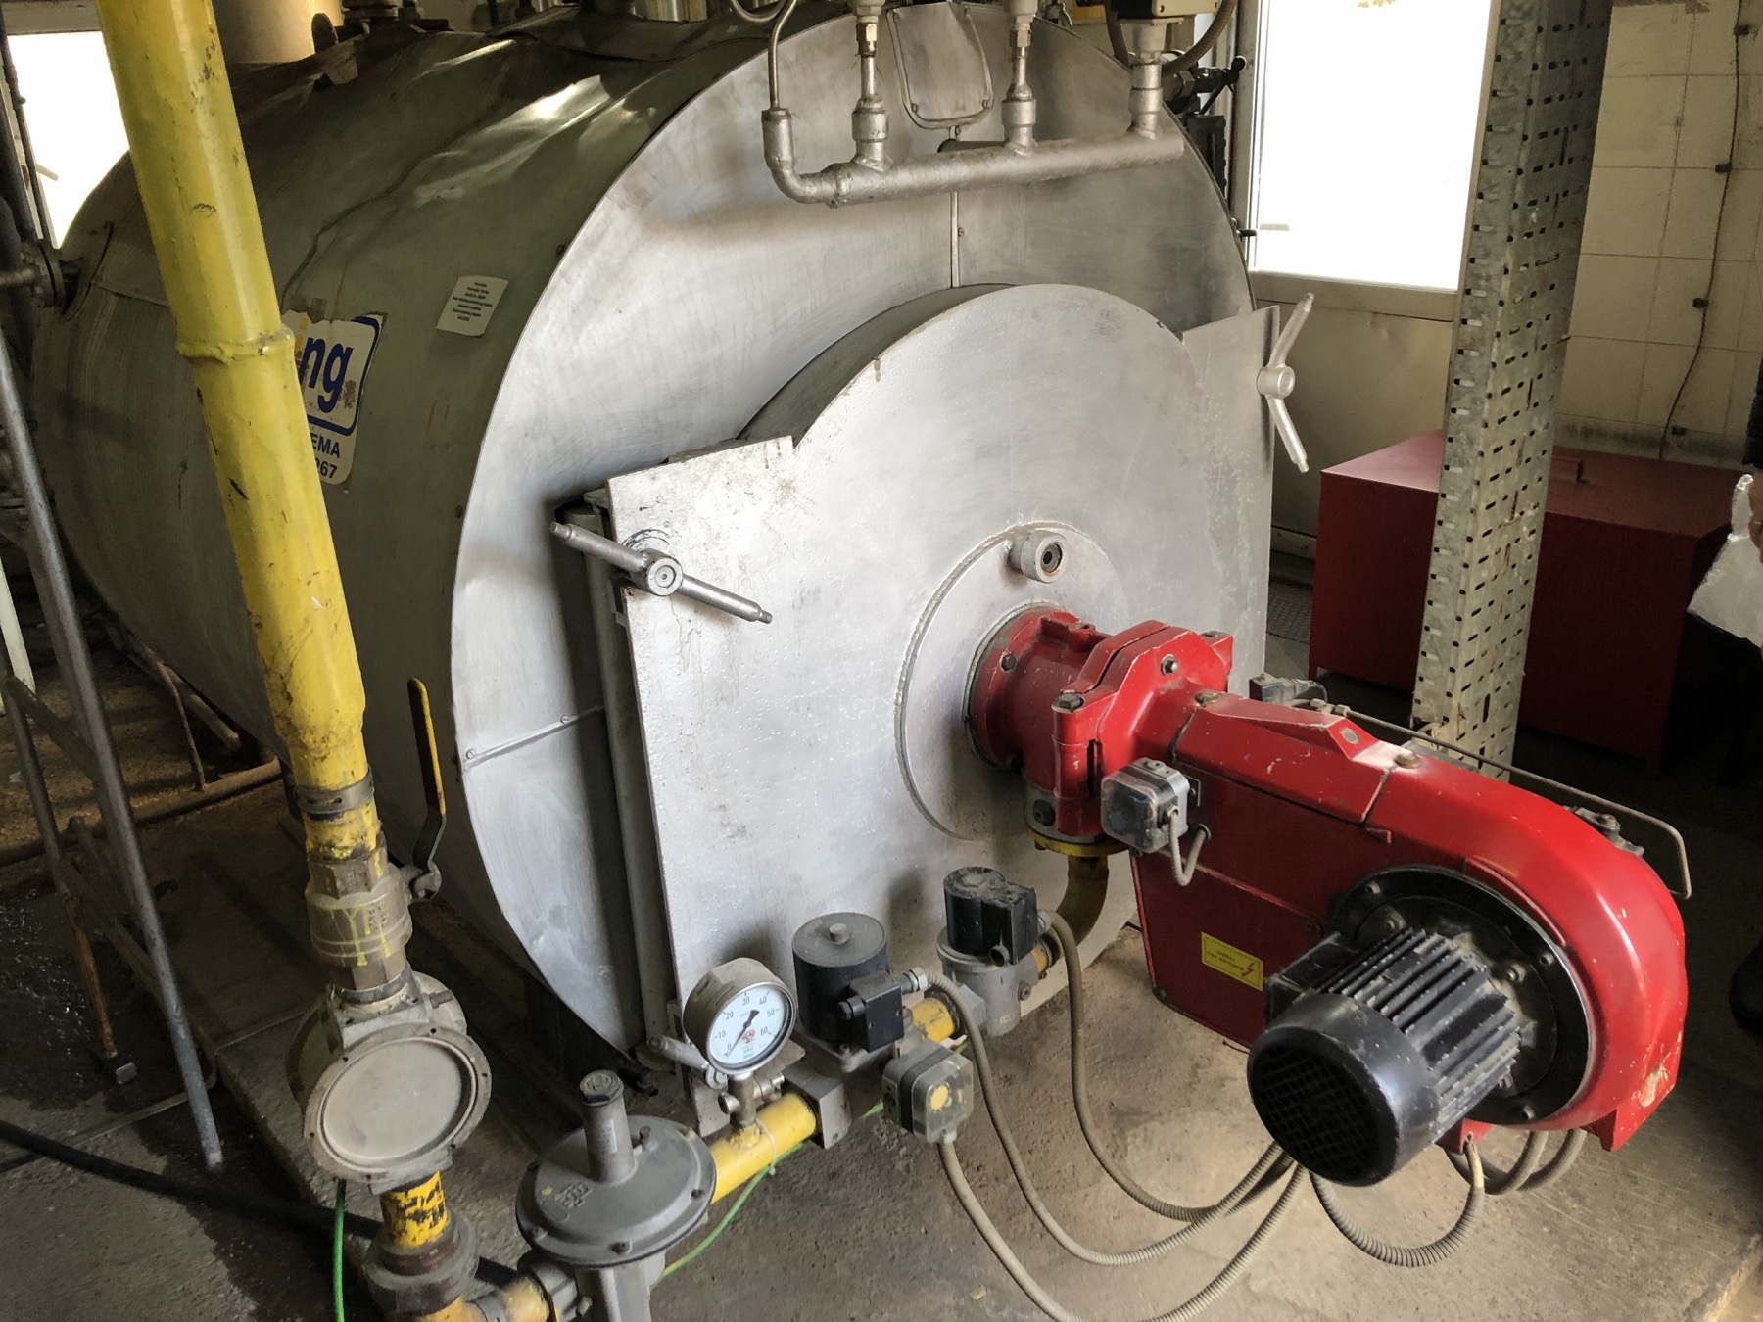
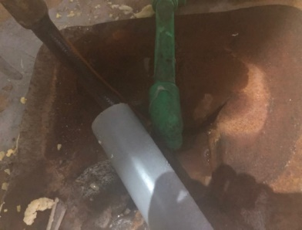
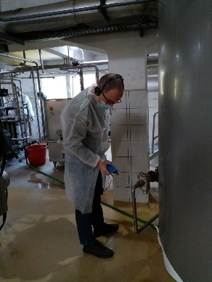
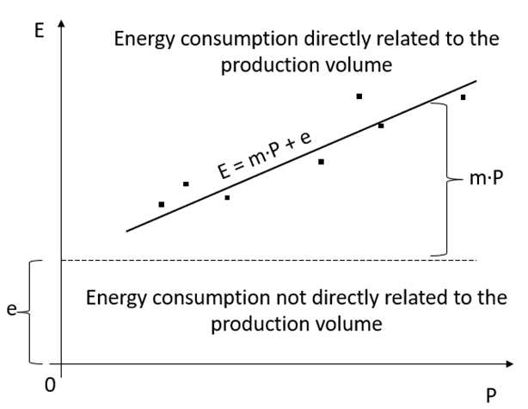
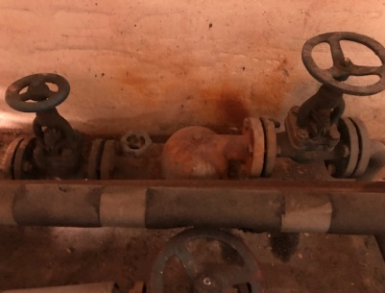

Energy Auditing
Data analysis
Measurement
Calculations
Estimations
Energy efficiency
Electrification
$$P=i∙U∙\sqrt{3}∙\cos{φ}$$
Lo‐carbon Fuels

Slide 12
Energy Auditing – Example

Slide 13
Energy Auditing – Example
Defining and prioritizing energy efficiency improvement measures

Slide 14
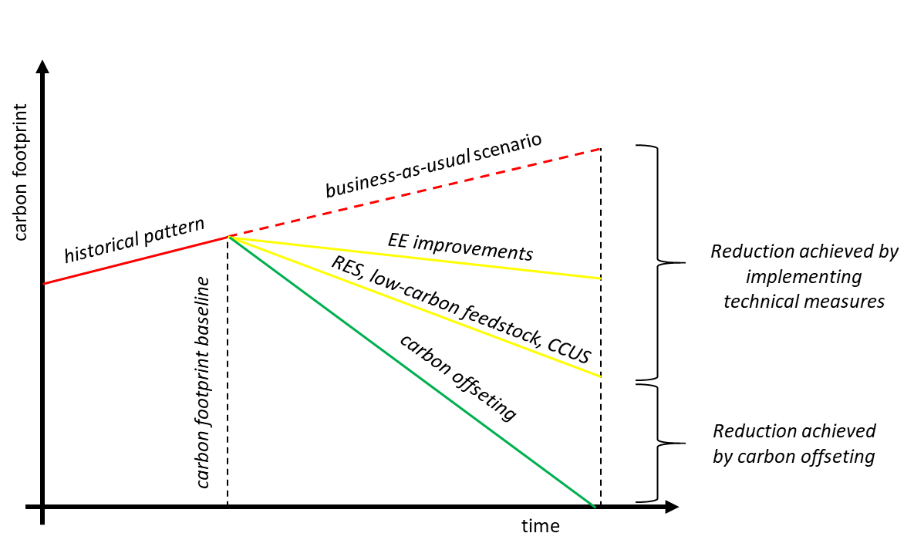
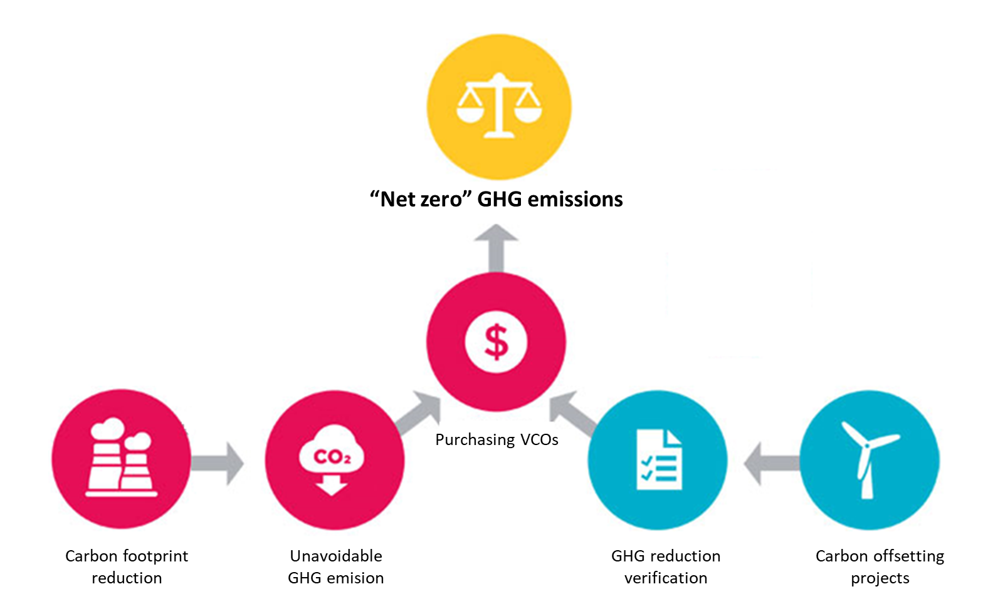
Carbon Compensation (Offsetting)

Slide 15
Carbon Offsetting Scenarios

Slide 16



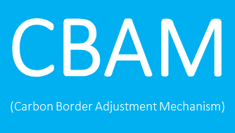
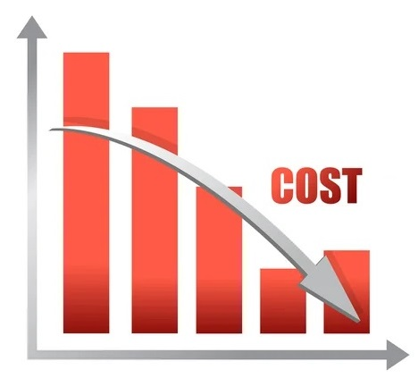

Why a Smaller Environmental Footprint Is Good for Business?
Enhanced Brand Image and Corporate Reputation
Regulatory Compliance and Reduced Risks
Cost Savings i.e. Financial Benefits Through Efficient Practices
Building Long-Term Sustainability

Slide 17

Conclusion
More sustainable practices - beneficial to both the environment and the company itself
Companies who recognise the need of addressing climate change - responsible industry leaders
Reducing a company's carbon footprint is a complex approach that allows them to achieve significant environmental and economic benefits
Such efforts promote a culture of sustainability throughout the organisation, increasing stakeholder trust and securing a competitive advantage
The journey to carbon neutrality may be a challenging one, but the benefits are immense.

Slide 18
Thank you very much!
2023-1-EL01-KA210-ADU-000164781
The European Commission support for the production of this publication does not constitute an endorsement of the contents which reflects the views only of the authors, and the Commission can not be held responsible for any use which may be made of the information contained therein

