Slide 1





Module 5:
Funding Green Dreams
Reducing the environmental footprint of Female Entrepreneurship
WomEn Going Greener

Slide 2


Introduction
  Green Entrepreneurship: sustainable business practices
  Global Importance:
  Addresses environmental challenges
  Promotes economic growth alongside sustainability.
  Greece's Role: natural resources, entrepreneurial spirit, integration of green practices Challenges: Transition requires significant investment and innovation.
  EU Support:
  Provides substantial funding and policy frameworks.
  Subsidies reduce financial burden, encourage innovation, and enhance competitiveness.
  Opportunities: resilient, eco-friendly economy,sustainable development in the region.

Slide 3
Green financing
Definition: Green finance refers to structured financial activities that aim to improve environmental impact and build a resilient future.
Key Areas of Focus: Renewable Energy & Efficiency: Financing projects that promote clean energy.
Pollution Control & Biodiversity
Circular Economy
Sustainable Land Use
Global Objectives
Return & Environmental Benefits
Accountability
Promoting Green Finance:
Regulatory Frameworks
Public-Private Partnerships
Sectoral Financing
Key Stakeholders: Governments, businesses, financial markets, banks, investors, micro-credit entities, insurance companies

Slide 4
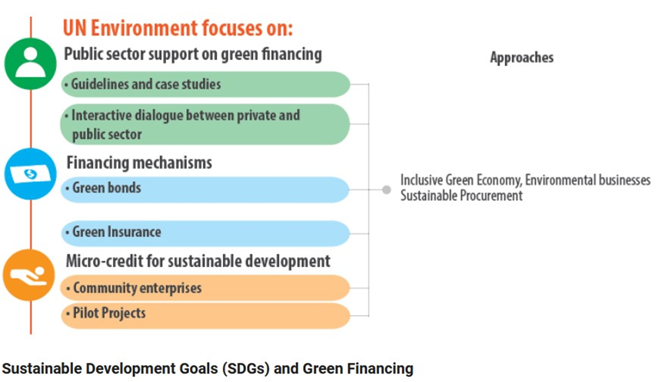
Green financing

Slide 5
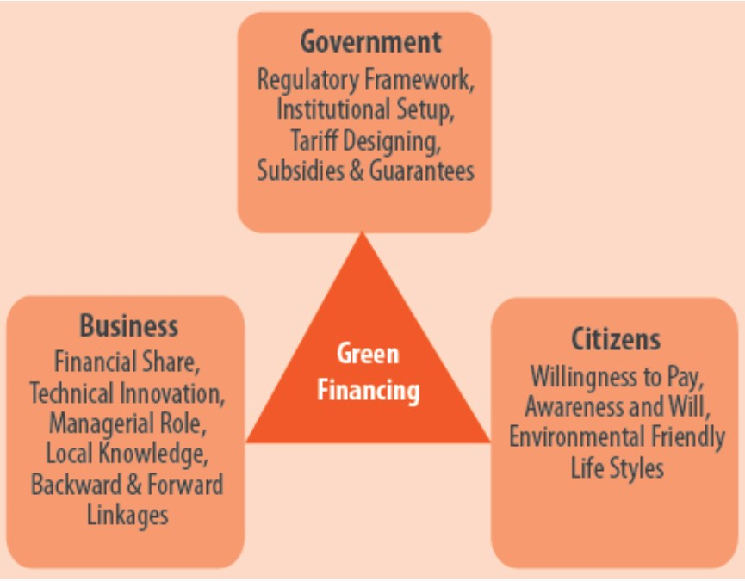
Green financing

Slide 6
Women and green entrepreneurship
1.Women and green entrepreneurship are interconnected, emphasizing innovation, sustainability, and societal well-being.
2.Women entrepreneurs bring unique perspectives and innovative solutions, particularly in green entrepreneurship.
3.Women-led businesses contribute to sustainable products and services that address environmental challenges.
4.2These businesses often prioritize social and community impact, aligning with the goals of green entrepreneurship.
4.1There is a growing push for policies and funding that offer subsidies and incentives for green business initiatives.
4. Women in green entrepreneurship can promote gender equality by providing access to resources.
5.Empowering women in this field can lead to significant economic growth and job creation.
6.Women leaders in green entrepreneurship serve as role models and advocates for sustainable practices.
6.1They inspire other women to enter the field and promote environmental stewardship.
a

Slide 7


Why women in business is good business?
a
Unique Perspective: Women, being more affected by climate change, offer innovative solutions for community resilience and adaptation.
Advancing Green Solutions: Women's strengths in leadership and innovation drive the development of green technologies and climate solutions.
Supporting women in environmentally and climate-related businesses has the potential to increase profits and have a more long-lasting effect for several reasons.
Market Influence: Women have a comparative advantage in creating climate technologies that benefit women consumers and influence up to 80% of buying decisions.
High Performance: Women excel in environmental, social, and governance (ESG) metrics, as well as in leadership, problem-solving, and innovation.

Slide 8

Financial Tools “at the service’’ of green entrepreneurship
National Bank provides:
Subtitle Green Loans:
Provide capital for businesses and consumers to implement renewable energy systems and energy-efficient equipment.
Green Bonds:
Securities issued to finance environmentally friendly projects like renewable energy or sustainable transport.
Green Funds:
Investment funds that pool money to invest in green assets, such as renewable energy and sustainable infrastructure.
Green ETFs:
Exchange-traded funds that track stocks or indices focused on green investments.
Green Private Equity & Venture Funds:
Provide capital to startups or companies engaged in sustainable projects or technologies.

Slide 9
The EU’s Sustainable Finance Strategy
Importance in Finance:
Increasing focus on sustainable finance due to its role in providing capital for environmentally and socially responsible investments.
ESG Financial Solutions:
Top asset managers and investment firms integrate Environmental, Social, and Governance (ESG) factors at every stage of the investment process.
Key Definitions:
Sustainable Finance:
Incorporates ESG factors in financial decisions, covering areas like pollution prevention, biodiversity, circular economy, and climate change. The EU’s Sustainable Finance Strategy
Green Finance:
A subset of sustainable finance, focused on funding projects with positive environmental impacts, such as reducing greenhouse gas emissions and pollution.
Climate Finance:
A subset of green finance, dedicated to funding initiatives for climate change adaptation and mitigation.
Alignment with Policies:
Taxonomy Regulation & European Green Deal: Green finance definitions align with these frameworks.
Green Finance Study Group of 20 : Provides a broader context for green finance, emphasizing global standards.

Slide 10
How can women access grants, loans, and investors?
Funding Challenges:
Securing financing is a major hurdle for green entrepreneurs, especially women, who face significant barriers in accessing capital.
Financing Gap:
In developing countries, the gap is particularly stark, with a $1.5 trillion shortfall.
Gender Disparity:
Women are less likely to receive funding from angel investors and venture capitalists, who often favor male-led ventures.
Overcoming Obstacles:
Exploring alternative funding options is essential for women to achieve their green business goals.

Slide 11
Funding Options for Women Green Entrepreneurs
Grants:
Description: Non-repayable funds provided by governments, foundations, and organizations.
Examples:
Horizon Europe (EIC Accelerator)
European Social Fund Plus (ESF+)
Female Founders Fund
Loans:
Description: Borrowed funds that must be repaid with interest. Useful for starting or expanding businesses, purchasing equipment, and covering operational costs.
Examples:
EBRD Women in Business Programme
SME Go Green (EBRD)
Women’s World Banking Microfinance Loans
Investors:
Description: Provide capital in exchange for equity or profit-sharing. They also offer market access, networking, and strategic advice.
Examples:
SheEO
Pipeline Angels
Chrysalis Capital
How can women access grants, loans, and investors?

Slide 12
Funding Opportunities for Greener SMEs
  Eco-Preneurs:
  Businesses committed to environmental sustainability, aiming to minimize negative impacts and maximize positive contributions.
  Government Incentives:
  Types of Grants and Subsidies: State grants, energy efficiency grants, R&D grants, and subsidies for renewable energy.
  Benefits: Support for green businesses to make environmental impacts and thrive in competitive markets.
  Incubators and Accelerators:
  Role: Provide crucial support, funding, and resources for startups to develop and grow.

Slide 13
Funding Opportunities for Greener SMEs
  Strategic Partnerships:
  Advantages: Expand reach, access new markets, and share knowledge.
  Approach: Align goals and values, collaborate on marketing, and share resources.
  European Commission (CINEA):
  Function: Manages funding programs focused on sustainability, climate resilience, and infrastructure.
  Impact: Channels financial resources and expertise to projects with lasting environmental and societal benefits.

Slide 14
LIFE Program Funding Opportunities
Objective:
Support the transition to a resilient, climate-neutral, and sustainable economy while safeguarding the environment.
Sub-Programs:
Nature and Biodiversity:
Focus: Protection and restoration of nature, biodiversity, and habitats.
Support: Projects related to EU Birds and Habitats directives, Natura 2000 network, and biodiversity strategy for 2030.
Circular Economy and Quality of Life:
Focus: Improve environmental quality and transition to a circular, energy-efficient, and climate-resilient economy.
Support: Initiatives on waste recovery, soil and water management, and chemical management. Includes Standard Action Projects (SAPs) and Strategic Integrated Projects (SIPs).

Slide 15
LIFE Program Funding Opportunities
Climate Change Mitigation and Adaptation:
Focus: Promote energy efficiency, renewable energy, and climate resilience.
Mitigation: Supports projects on farming, land use, peatlands, and greenhouse gas reduction.
Adaptation: Co-finances initiatives for urban adaptation, infrastructure resilience, and sustainable water management.
LIFE Clean Energy Transition:
Focus:
Implement EU sustainable energy policies and support the transition to a climate-neutral economy.
Support: Funding for policy frameworks, technology roll-out, private finance attraction, and citizen involvement in clean energy.
Budget: Nearly EUR 1 billion for 2021–2027.
LIFE Program Goals:
Assist in transitioning to a climate-neutral, energy-efficient, and sustainable economy.
Enhance environmental quality and biodiversity.
Address ecosystem degradation and promote circular economy practices.

Slide 16
The European Investment Bank’s Sustainable Finance Strategy
EIB Group Gender Strategy:
Objective: Promote gender equality and women's economic empowerment.
Support: Provides financial and technical assistance to women-led businesses
Financing Initiatives:
European Fund for Strategic Investments (EFSI) and InnovFin:
Focus: Offers tailored financing solutions for women entrepreneurs in innovative and sustainable sectors.
SheInvest Initiative:
Purpose: Boost gender equality and economic empowerment of women in Africa.
Achievements: Supported €2 billion in gender-smart investments, including credit lines with local banks and microfinance for women-owned enterprises.
Partnerships: Collaborates with institutions like Uganda Development Bank and Ecobank Malawi.
Collaborations:
Microfinance Institutions: Provides small loans and financial services targeting women entrepreneurs.
Local Banks: Enhances access to credit facilities and financial services.
International Organizations: Works with the European Commission, UN, and NGOs on gender-focused and sustainable development projects.

Slide 17
European Bank for Reconstruction and Development
Western Balkans Women in Business Financing Programme:
Objective: Enhance women’s participation in business by supporting women-led SMEs with finance and expertise.
Funding: €6.5 million from Sweden, Luxembourg, and EBRD Shareholder’s Special Fund
Key Financing Packages:
Banca Intesa Beograd (€72 million total):
Risk-Sharing Framework: €50 million to share risk with local SMEs; EBRD guarantees up to 65% of each sub-loan.
SME Go Green Programme (€15 million): Supports green investments and sustainability practices; 70% of funds allocated to Green Economy Transition (GET) projects.
Senior Loan (€7 million): Provides financing to women-led SMEs under the Western Balkans Women in Business programme; includes business advisory services.
UniCredit Bank Serbia:
SME Go Green Programme:
Contributes up to €10 million for Green Economy Investments; 70% of funds targeted at GET-eligible projects.
a

Slide 18
Creating and Managing a Green Investment Fund
Setting Up a Green Investment Fund:
Legal and Regulatory Framework: Ensure compliance with laws, regulations, and industry standards.
Governance and Management Structure: Establish transparent governance with clear roles for the board, management team, and investment committee.
Investment Strategy and Objectives:
Define focus, target sectors, risk tolerance, and expected returns (financial and impact).
Effective Management:
Sourcing and Evaluating Investments: Identify and assess opportunities aligned with the fund's strategy.
Portfolio Management: Monitor and manage investments to optimize performance and impact.
Stakeholder Engagement: Maintain transparent communication with investors, investees, and stakeholders.

Slide 19
Creating and Managing a Green Investment Fund
Benefits of Green Investments:
For Businesses:
Leverage: Green investments can boost market position.
Cost Savings: Green technologies reduce energy, water, and resource consumption.
Enhanced Competitiveness: Investing in sustainability enhances profitability.
For Vendors and Producers:
Increased Demand: Rising demand for green solutions as businesses meet sustainability goals.
New Opportunities: Platforms like GEFF provide visibility and new markets for green technologies.
For the Environment:
Pollution Reduction: Green energy sources cut pollution and conserve resources.
Healthier Environment: Reducing greenhouse gases and pollutants contributes to overall environmental health.

Slide 20
Crowdfunding for Green Dreams:
Definition & Overview:
Crowdfunding: Collecting small contributions from many individuals via the internet to fund ventures without traditional financial intermediaries (Mollick, 2014).
Types:
Investment-Based: Includes crowd-lending and equity crowdfunding.
Non-Investment-Based: Includes reward-based and donation-based crowdfunding (Shneor & Vik, 2020).
Crowdfunding Models:
Donation-Based: Contributions are made without expectation of returns.
Lending-Based: Funds are provided with the expectation of repayment with interest.
Equity-Based: Investors receive shares or ownership stakes in the company.
Reward-Based: Backers receive non-monetary rewards, such as products or services (Wang et al., 2022).
Factors Affecting Success:
Project Quality: High-quality, well-presented projects have higher success rates.
Team Credibility: Trustworthiness and competence of the project team.
Investor Support: Strong backing and engagement from the investor community.
Message Framing: Positive messages are effective for certain sectors like agri-food, while negative messages may work better for climate and clean energy projects (Rossolini et al., 2021).

Slide 21
Crowdfunding for Green Dreams:
Investor Motivation:
Altruism: Desire to support meaningful causes.
Personal Satisfaction: Fulfillment from contributing to a project.
Project Enthusiasm: Excitement about the project's goals and outcomes (Bagheri et al., 2019; Chen et al., 2021).
Green Crowdfunding Platforms:
Kickstarter for Sustainability: Focuses on eco-friendly and sustainable projects.
Seedrs: Offers equity crowdfunding with a green focus.
Indiegogo: Provides flexible funding for green initiatives.
GoFundMe: Supports environmental causes with donation-based crowdfunding.
Patreon: Offers ongoing support for creators with sustainable missions.
Application in Green Finance:
Crowdfunding is increasingly used by green start-ups to raise funds for sustainable projects.
Essential to set clear funding goals and craft a compelling message. Enhances public engagement and broadens funding sources beyond traditional venture capital.

Slide 22
Funding Models:
- All-or-Nothing (AON): In this model, projects must meet their funding target within a specified timeframe. If the target isn't reached, all contributions are refunded, ensuring that only fully funded projects proceed.
- Keep-It-All (KIA): Here, projects receive the funds raised regardless of whether they meet the target. While riskier, KIA allows partial funding to support project development.
- Hybrid Models: Some platforms combine AON and KIA elements, offering flexibility to project creators.

Slide 23
Thank you very much!
2023-1-EL01-KA210-ADU-000164781
The European Commission suport for the production of this publication does not constitute an endorsement of the contents which reflects the views only of the authors, and the Commission can not be held responsible for any use which may be made of the information contained therein

