Slide 1





SOLAR
ENERGY
Harvesting Solar Power
WomEn Going Greener

Slide 2

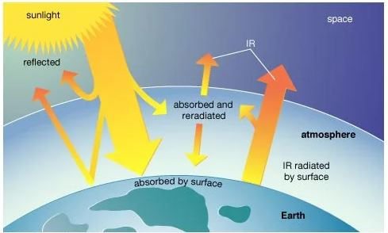

Solar Energy and Earth
The fusion reactions constantly occurring in the Sun generate vast amounts of energy, which is transmitted to the Earth in the form of electromagnetic radiation.
After passing through the atmosphere, around 1,000 watts per square meter reach the Earth s surface under optimal conditions.
The radiation that reaches the Earth s surface is called global solar radiation and represents the sum of direct radiation, diffuse radiation and reflected radiation.

Slide 3
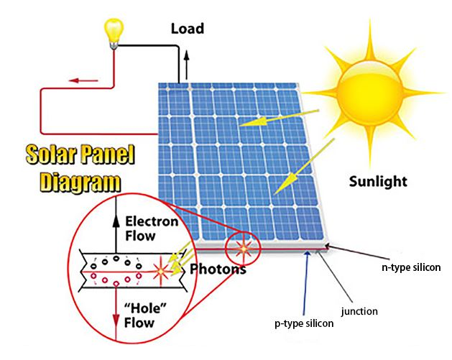
How Solar Panels Work
1. Photon Absorption: When sunlight (photons) hits the solar panel, the energy is absorbed by the PV cells.
2. Electron Excitation: The energy from the photons excites the electrons in the semiconductor material, causing them to separate from their atoms.
3. Creation of an Electric Field: The structure of the PV cell contains built-in electric fields due to the layers of semiconductor materials (usually n-type and p-type silicon). This electric field forces the free electrons to move in a specific direction.
4. Generating Current: The movement of these electrons creates an electric current.

Slide 4
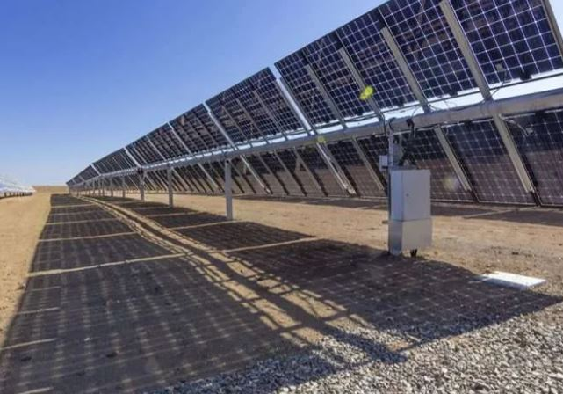
Types of Solar Panels and materials for Solar Cells
1. Monocrystalline Solar Panels (most commonly used):
Material: Made from a single continuous crystalline
structure of silicon
Efficiency: Typically 15-20%.
2. Polycrystalline Solar Panels (nearly phased out from the market):
Material: Made from multiple silicon crystals that are melted together.
Efficiency: Typically 10-15%.
3. Bifacial Solar Panels:
Material: Can be made from either monocrystalline or polycrystalline cells.
Efficiency: Typically 15-20%, but they can produce up to 30% more electricity by capturing light from both sides.
Research on More Efficient Panels
Perovskite Solar Cells – 28 % efficiency.
Multi-Junction Solar Panels - 40 % efficiency
In addition to silicon-based solar panels, there are also thin-film panels made from materials like cadmium telluride (CdTe) and copper indium gallium selenide (CIGS). They are lighter and more flexible but generally less efficient than silicon panels.

Slide 5
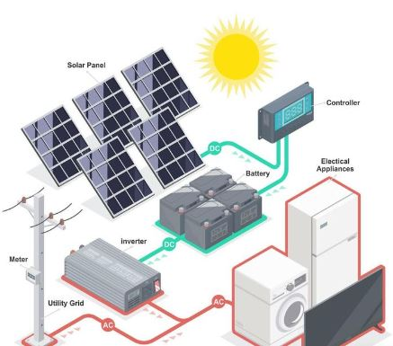
Electricity production: From Direct to Alternating Current
Direct Current from Panels: When solar panels generate electricity, it is direct
current (DC). This current can be directed to batteries for storage or sent directly
to an inverter.
Batteries: If the system uses batteries, they store the direct current, which can
later be used when there is no sunlight, e.g., at night. From the batteries, the
current again passes through an inverter before being used in the household.
Inverter: This is a key component of any solar system. The inverter converts
direct current from the panels or batteries into alternating current, which can be
used in households or fed back into the power grid.
Why we use alternating current then?
More Efficient Transmission Over Long Distances
Simpler Distribution
Safety and Standardization:

Slide 6
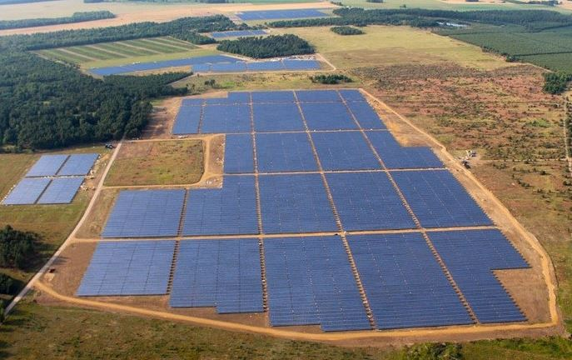
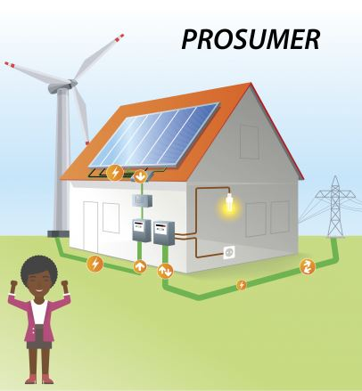
The most common uses of solar power plant
Pure Production Power Plant: Solar systems installed solely for energy production for the grid focus on generating the maximum amount of electricity, which is sold to distribution companies.
The main disadvantage of such power plant is that they occupy arable land.
Prosumer (Producer + Consumer): When a solar power plant is connected directly to a household and the power grid, the plant owner becomes a prosumer.
This means that they not only produce energy but also use part of that energy for their own needs. The excess energy can be fed into the grid, for which the prosumer can receive financial compensation or credit for future energy consumption.
The main advantage of such power plant is that they ae built exclusively on the rooftops of already constructed buildings.

Slide 7
INTEGRATING SOLAR ENERGY INTO AGRICULTURE
UN: the current world population is 8.2 billion, but it is expected to increase from 8 billion to 9.7 billion in 2050 and could peak at nearly 10.4 billion in the mid-2080s.
Also, 20% of the Earth's total land area has been degraded only between 2000 and 2015.
Key question: can food production and energy production from renewable sources be harmonized on the same land?
The potential offered by solar energy is enormous. However, there are many reasons why this potential has not been used to a sufficient extent. Despite the promising potential for solar photovoltaic technology to retrench global reliance on fossil fuels, large-scale PV development is experiencing complex challenges, including land use conflict and social resistance, which has previously been more commonly associated with large-scale wind farms. Social resistance is completely justified considering all the above: human needs are increasing due to the growing population, and the unpolluted and non-degraded land is decreasing. .
Therefore, to overcome obstacles and make the best of both, it was necessary to explore new approaches such as "Agrivoltaics" (solar and agriculture co-location).

Slide 8
AGRIVOLTAICS: SOLAR AND AGRICULTURE CO-LOCATION
Agrivoltaics, the co-development of land for both agriculture and PV, is an innovative and increasingly popular approach to solar development. Most large, ground‐mounted solar photovoltaic (PV) systems are installed on land used only for solar energy production. Such installations can threaten the local community, farmers and local food production.
But thanks to agrivoltaics systems (APV), it’s possible to co-locate solar and agriculture.
Co-location is defined as agricultural production, such as crop or livestock production or pollinator habitats, underneath solar panels or adjacent to solar panels. After they are installed, the solar panels leave about 90 percent of the free surface, on which food can be grown.
Numerous empirical studies have investigated BENEFITS of APVs:
capable of overcoming the dominant separation of food and energy production and increasing land productivity by 35–73%
partial shade of solar panels reduces the amount of direct sunlight reaching crops, changing the microclimate (day air temperature can bi 1.2°C lower under solar panels. Also, soil moisture can be up to 15% higher under PV panels.
different kinds of crops can be considered for cultivation in agrivoltaics systems - vegetables, herbs, and medicinal and aromatic plant....
Solar grazing: livestock can reduce the maintenance costs of trimming beneath panels and reduce the need to use herbicide.
Solar beekeeping: pollinator-friendly solar farms.

Slide 9
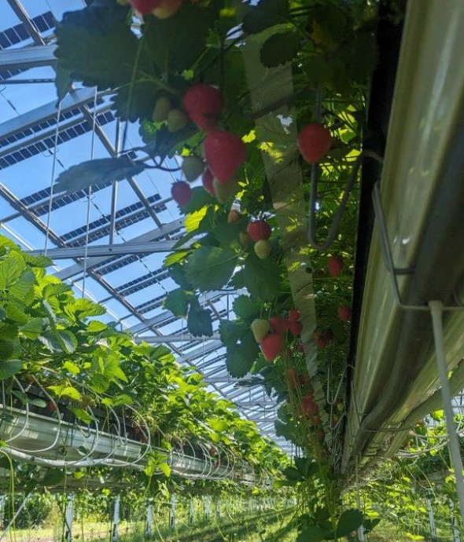
BENEFITS FROM AGRIVOLTAICS FOR FARMERS AND ENTREPRENEURS
Protection of crops from adverse weather conditions
Creating additional income from electricity production
Marketing benefits and contribution to sustainability
Reduction of labor costs and
consumed energy
Open-field strawberry cultivation in Senden, Germany
Source: https://www.britesolar.com/open-field-strawberry-cultivation
Solar Land Lease
Advice on project monitoring methodologies
Instructions on managing project finances
*Some limitations should be mentioned:
some solar industry professionals see agrivoltaic projects as complex and require extra effort to actualize, including added layers of intricacy in system design and increased coordination with stakeholders. It is therefore clear that such projects require more time, planning, and financial investment.

Slide 10
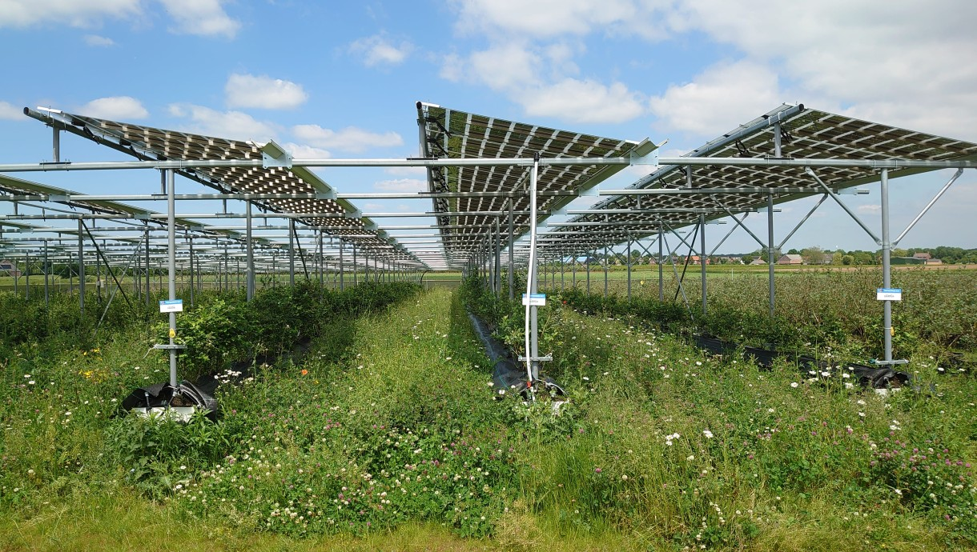
CASE STUDIES OF SUCCESSFUL SOLAR-POWERED FARMS
AGRIVOLTAICS IN EUROPE:
Currently, there are more than 200 agrisolar projects across Europe that exceed a combined capacity of 2.8 GW, including both pilot and commercial projects. These projects are mostly located across Switzerland, France, the Netherlands, Lithuania, Germany, Spain, Italy, Belgium, Austria, and the UK.
14 EU countries have incorporated solar PV under their Common Agriculture Policy (CAP) Strategic Plans. These countries are Austria, Belgium, Bulgaria, Cyprus, Czech Republic, France, Germany, Ireland, Italy, Luxembourg, Malta, Netherlands, Spain and Slovenia.
Open-field blueberry cultivation: Broekhuizen, The Netherlands
Source: https://www.britesolar.com/open-field-blueberry-cultivation

Slide 11
AGRIVOLTAICS IN ITALY
The first agrivoltaics plant of 1MW in Italy was built in 2011 in Apulia (ital. Puglia), located in the southern peninsular section of the country. This project will be upgraded: a new APV of 8 MW - combination of the production of green energy and wine, i.e. growing grapes.
Renantis in Scicli: in Ragusa, of 9.7 MW of new solar capacity. The plant is estimated to produce about 20 GWh of renewable energy per year, equivalent to the needs of more than 5000 households. At the site, the cultivation of native crops and energy production is combined. The crops have been selected in collaboration with the Department of Agriculture, Food and Environment of the University of Catania and include fruit trees, medicinal herbs, and lawn for sheep grazing, as well as bee breeding and honey production and other hive products.
In 2023, the construction of 13 agrivoltaics parks with a combined capacity of 593.7 MW has been approved. 12 of these projects will be located in Puglia, while 1 will be installed in the neighboring region of Basilicata.
Project in Basilicata: in the municipality of Genzano di Lucania (province of Potenza), a 10 MW power plant is currently under construction. This plant is expected to be able to generate 6162 MWh of clean energy per year when it is fully operational. This project involves the use of structures with a height of 1.5 meters that will allow the cultivation of different types of crops, beekeeping and grazing of sheep.
Solare Ramacca fiume – Gornalunga Project: in province of Catania, it will cover 68 hectares and will have an installed rated power of 34 527 MWp. It will be equipped with an integrated storage system with an input power of 11.4 MW on solar tracking facilities. This plant is expected to produce a net amount of 72 500 MWh/year of electricity from . The plant will have a significant impact on reducing CO2 emissions into the atmosphere, with an estimated over 29 000 tons per year.

Slide 12
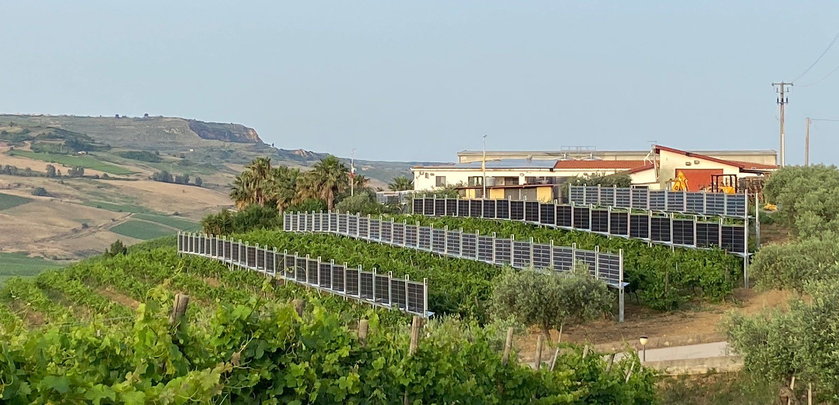
AGRIVOLTAICS IN ITALY
Agrivoltaics Open Labs: initiative located in Salaparuta (Sicily). That is one kind of open-air innovation laboratory in which the integration between the production of solar energy, agriculture, and biodiversity protection is tested. Given that grape growing, and wine production are part of culture, history, and tradition in Sicily, the company that owns the vineyard decided to combine wine and energy production and invest in PV installation. In this way, in addition to wine, the company also produces energy, reducing costs and at the same time favoring sustainability (the so-called Agrivoltaics Wine).

Slide 13
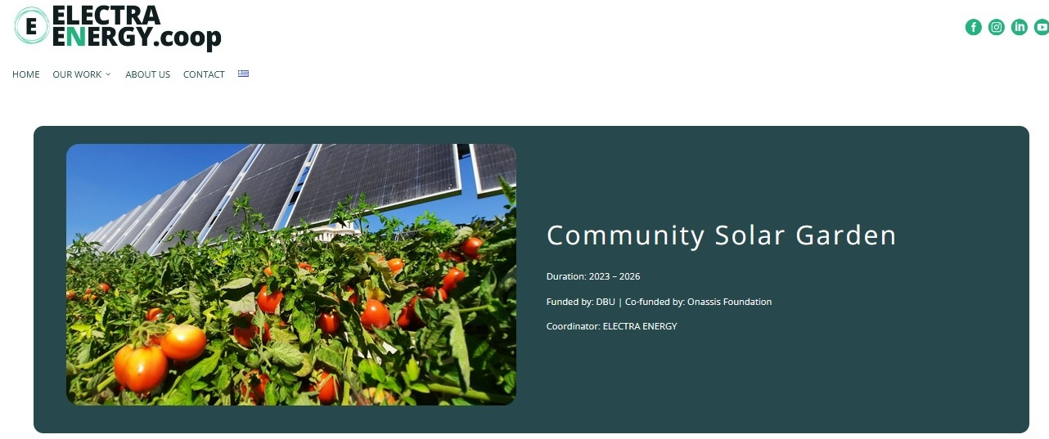
AGRIVOLTAICS IN GREECE
In Ioannina (Northwestern Greece, region of Epirus) the first urban community agriphotovoltaic project is already being planned and a replication will follow in Skopje, North Macedonia (two 10-15 kW agriPV stations). It is an urban vegetable garden that will be combined with the production of green energy from photovoltaic panels. The pilot will be coordinated by the local energy community CommonEn and the design will follow participatory procedures with the involvement of citizens and local stakeholders. CommonEn was founded in 2021 and it was pioneered by Electra Energy (member of a REScoop.eu).
The second project: a project by Greek startup Brite Solar which is building a production line in Patras for transparent solar panels for agrivoltaic production. This facility in Patras will have an annual capacity of 150 MW in peak terms. Brite Solar aims to then boost it to 300 MW in future (All projects are available at https://www.britesolar.com/)

Slide 14
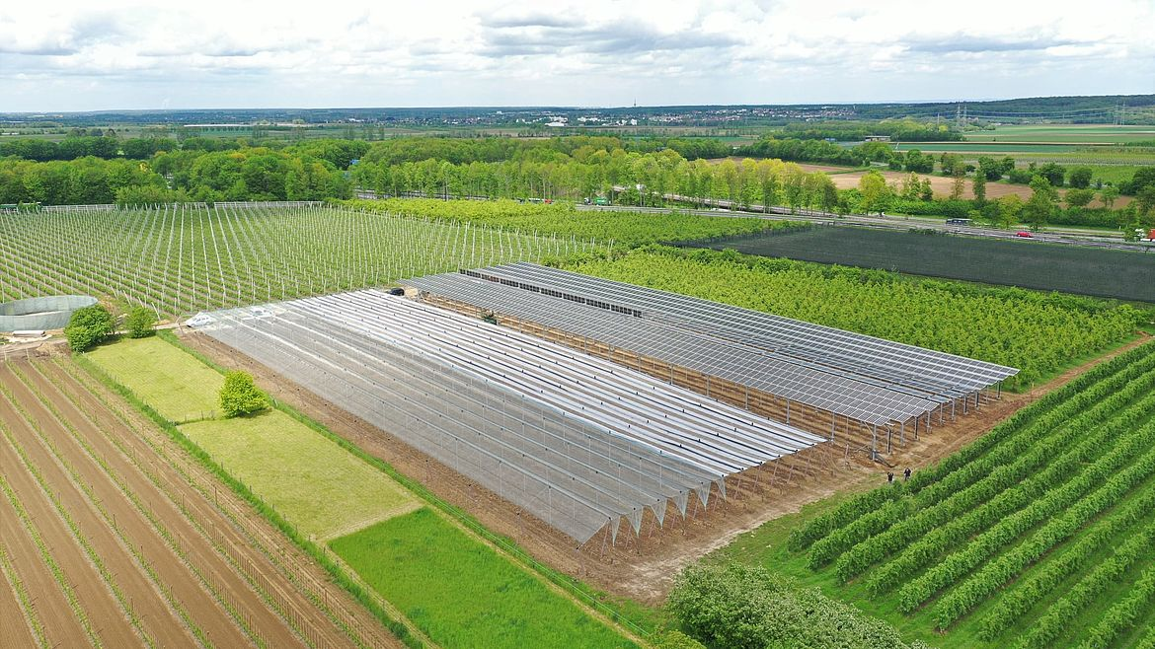
AGRIVOLTAICS IN GERMANY
In recent years APV projects have gained popularity in this country. According to a recently published study 72.4% of German farmers are willing to use agrivoltaics. In 2024, there are a couple of dozen agrivoltaics farms in Germany, especially in southern part (Bavaria and Baden-Württemberg), where the number of facilities is higher compared to the rest of the country.
The first agrivoltaics apple orchard in Germany: located in Gelsdorf in Rhineland-Palatinate (West Germany). This project started in 2021, at Nachtwey organic fruit farm with installed capacity of 300 kWp. The produced solar power is, among other things, used for the electric tractor on-site and to operate the electric pump of the irrigation system, which replaces a diesel generator.
Photo: The first agrivoltaics pilot on an apple orchard in Germany (Nachtwey organic fruit farm, Gelsdorf), Source: Baywa-re.de

Slide 15
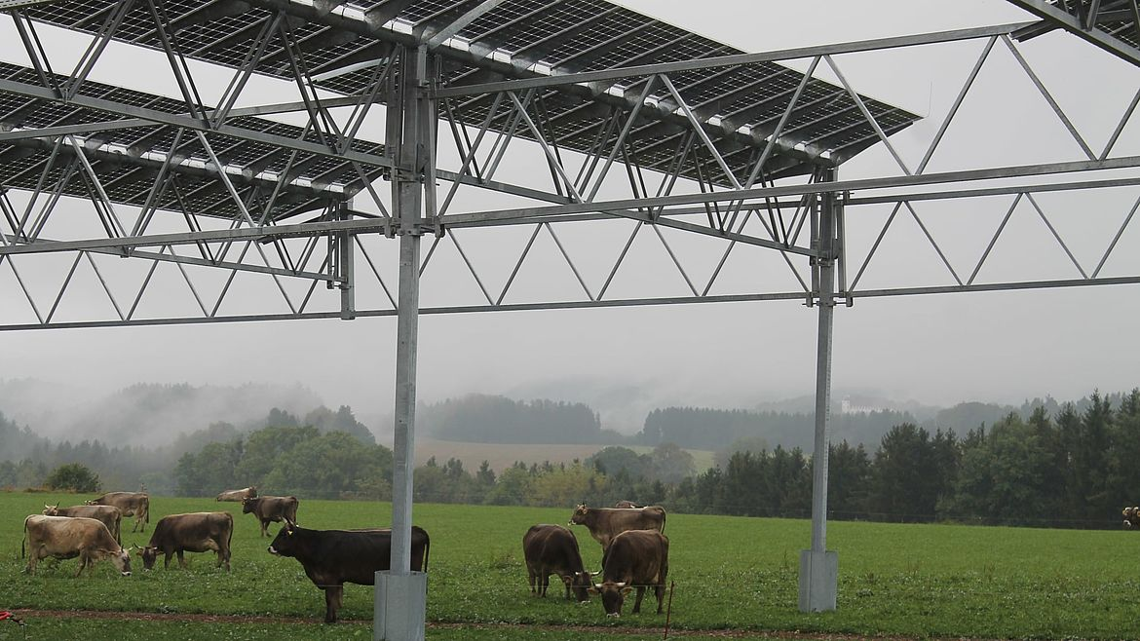
AGRIVOLTAICS IN GERMANY
APV-pilot plant at the “Heggelbach” biodynamic farm community run by six families, located in the municipality Herdwangen-Schönach, Baden-Württemberg (Southwest Germany). This project started in 2016 with installed capacity of 194 kWp. The farm community cultivates around 180 hectares. The agricultural basis comprises grass-clover ley (27 ha), cereals (30 ha), vegetables (25 ha), ware potatoes (12 ha), and pasture for the herd of cows. The innovative solution increased the land use efficiency on the test area by more than 60%.
Photo: APV plant at the “Heggelbach” biodynamic farm community, Source: Baywa-re.de

Slide 16
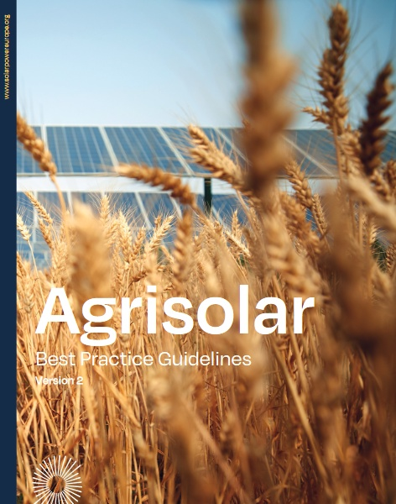
CASE STUDIES OF SUCCESSFUL SOLAR-POWERED FARMS
Agrisolar Best Practice Guidelines
This report provides guidance for the deployment of sustainable Agri-PV practices for solar industry stakeholders; it also addresses wider stakeholder groups and serves as an informative tool for the Agrisolar sector.
Available at: https://www.solarpowereurope.org/insights/thematic-reports/agrisolar-best-practice-guidelines-version-2-2

Slide 17
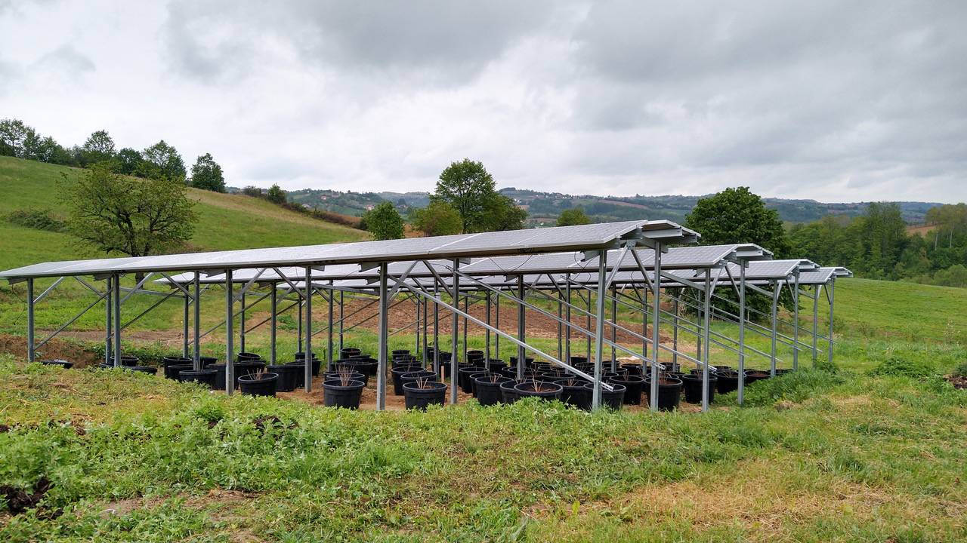
AGRIVOLTAICS IN SERBIA
Solar Harvest: Serbia’s first agrisolar power plant
In February 2024, the Organic farm “Organela” became home to Serbia’s first agrisolar power plant. Located in a rural area of Western Serbia and surrounded by natural landscapes, Organela produces organic fruit and vegetables, and from now on it will also generate green electricity . The solar power plant has 48 photovoltaic panels, with a combined capacity of 17.5 kW.
Under the solar panels, Organela farm will grow currants and rocket. It is estimated that this agrisolar will reduce CO₂ emissions by 28 tons per year and that the annual energy yield will be 25.9MWh.
The Solar Harvest is the project of the Elektropionir energy cooperative (in cooperation with Organella Farm)

Slide 18
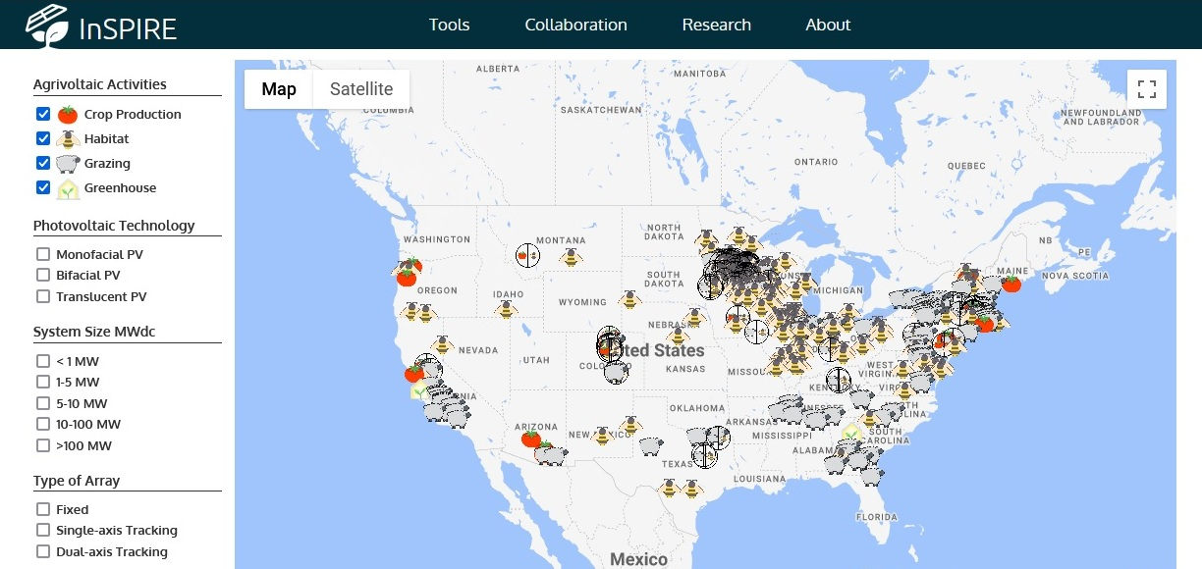
AGRIVOLTAICS IN USA
By August 2024, the National Renewable Energy Laboratory has identified 571 agrivoltaics projects in the United States (with 10GW), of which crop production includes 35 projects (79MW, 360 Acres) and solar grazing includes 205 projects (7555 MW, 49 229 Acres). The most numerous agrivoltaics projects in USA are definitely “pollinator habitats” (418 sites with 4293 MW, which covers 23 784 Acres).
U.S. Department of Energy which developed the “Farmer's Guide to Going Solar” as a form of support for all new farmers who want to join this initiative.
Sheep are the most common
solar-grazing animals.
Food growing under solar panels in the USA: vegetables, fruits, medicinal and aromatic herbs.

Slide 19
Thank you very much!
2023-1-EL01-KA210-ADU-000164781
The European Commission suport for the production of this publication does not constitute an endorsement of the contents which reflects the views only of the authors, and the Commission can not be held responsible for any use which may be made of the information contained therein

